Slide 1

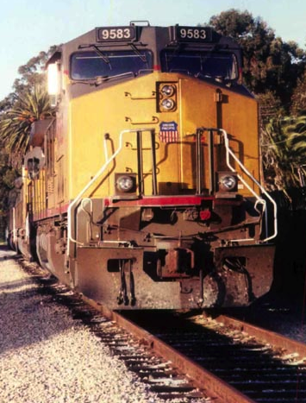
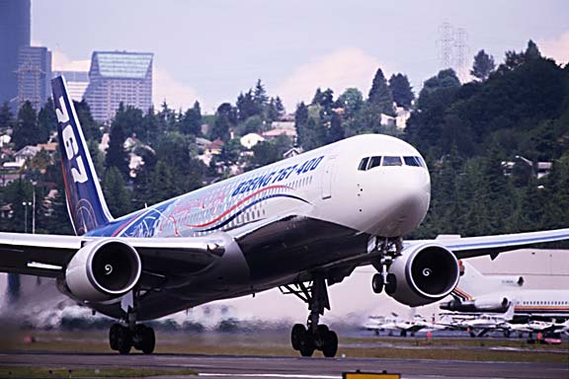
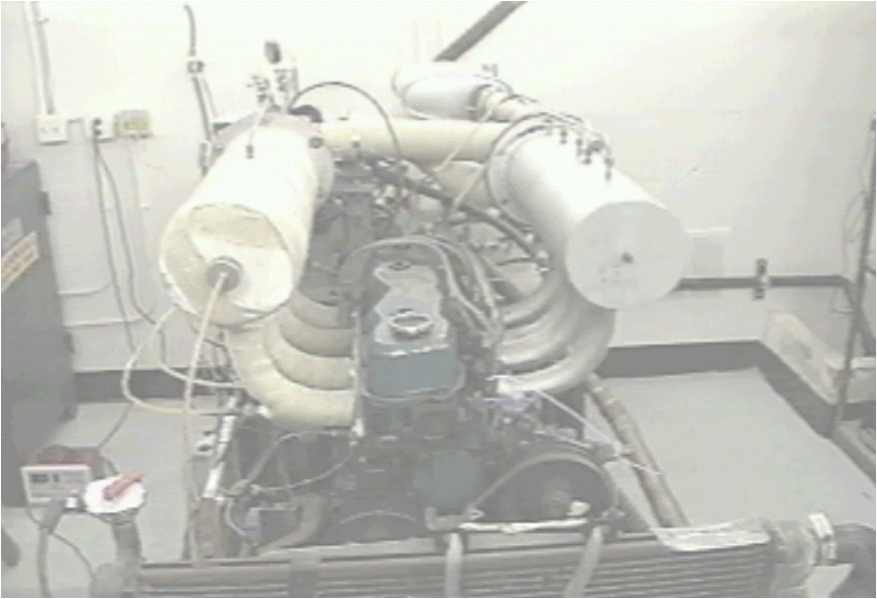

AME 436
Energy and Propulsion
Lecture 9
Unsteady-flow (reciprocating) engines 4:
Non-ideal cycle analysis

Slide 2
Outline
AirCyclesForRecips.xls spreadsheet - how it works and how to use it
Some non-ideal effects
  Irreversible compression/expansion
  Heat transfer to gas during cycle
  Finite burn time / spark advance
  Exhaust residual
  Friction
Factors that limit maximum RPM
Performance plots - Power & Torque vs. RPM

Slide 3
AirCycles4Recips.xls
Thermodynamic model is exact, but heat loss, burn rate, etc. models are qualitative
Constant γ not realistic (changes from ≈ 1.4 to 1.25 during the cycle) but only affects results quantitatively (not qualitatively) (1 of 2 most significant weaknesses of AirCycles4Recips.xls)
Heat transfer model
  ΔT ~ h(T_{wall} -T_{gas}), where dimensionless heat transfer coefficient (h) & cylinder wall temperature (T_{wall}) are specified constants - physically reasonable
  h is a "Sherwood number" = h/ρC_{P}LN, where h is the dimensional heat transfer coefficient (W/m²K) and L is a characteristic dimension (e.g. cylinder diameter) (LN is a characteristic velocity; if L = stroke then LN = mean piston speed)
  Increments each cell not each time step
  Doesn't include effects of varying area, varying turbulence, varying time scale through piston motion, etc. on h

Slide 4
AirCycles4Recips.xls
Work transfer from step i to step i+1
δW = δQ - dU (1st Law of Thermo, conservation of energy)
δQ = C_{v}h(T_{wall} -T_{i}) + (Δf)Q_{R}/C_{v}
  dU = U_{i+1} - U_{i} = C_{v}(T_{i+1} - T_{i}) (constant C_{V})
  Δf = increment of fuel burned in current step
Friction loss is a specified FMEP
Use latest version from AME 436 website - some plots embedded in lecture notes were built with earlier versions
Model considers only 1 gas in cylinder - improved model should consider 2 separate gases, burned & unburned, with combustion increasing amount of burned gas (2nd significant weakness of AirCycles4Recips.xls)

Slide 5
AirCycles4Recips.xls - intake process
Intake process spread across 25 Excel cells (i = 1, 2, … 25) ; 1/25 of total cylinder volume increase in each successive cell
Pressure P_{intake} & specific volume v_{intake} assumed constant
In first row of intake process
  If "Exhaust Residual" = FALSE then T = T_{intake}
  If "Exhaust Residual" = TRUE then T = final exhaust temperature after expansion, blowdown, and intake start
If "Exhaust residual" = TRUE, iteration required since the exhaust temperature is not known until the end of the cycle; use SOLVE button to update solution after changing any input parameter (otherwise SOLVE button does nothing)
After first row T_{intake} = T of the fresh gas but it mixes with gas already in cylinder that has different T due to heat loss /gain; mixed gas T conserves internal energy of fresh + existing charge:
(m_{i+1})C_{v}T_{i+1} = m_{i}C_{v}T_{i} + ΔmC_{v}T_{intake}
where Δm = m_{i+1} - m_{i} = (V_{i+1}-V_{i})/v_{intake} = (V_{i+1}-V_{i})/(RT_{intake}/ P_{intake})

Slide 6
AirCycles4Recips.xls - compression
Compression spread across 25 cells; 1/25 of total cylinder volume decrease in each successive cell
Done in two steps:
  (1) Wall heat transfer at constant volume
  (2) Adiabatic compression according to the usual PV^{γ} relations; may be irreversible according to (see lecture 7, pages 17-18)
η_{comp} = 1 ⇒ reversible adiabatic process
Compression ends at volume V_{c} + V_{d}*BurnStart, where BurnStart is a specified number (0 ≤ BurnStart < 1)
BurnStart must be ≥ 0, i.e. combustion must start at or before minimum volume (a limitation of the spreadsheet, not a fundamental limitation of cycles)
If BurnStart > 0, some compression occurs during heat addition step (next…)

Slide 7
AirCycles4Recips.xls - combustion
Same two-step process of heat transfer at constant V + adiabatic compression, but now both heat transfer to/from wall AND heat input due to combustion
Δf = fraction of fuel burned during step
By default (Burn Rate Profile = 0) Δf = f/25, but can use Burn Rate Profile > 0 or < 0 to have more burning near end (realistic) or beginning (unrealistic) of combustion process

Slide 8
AirCycles4Recips.xls - combustion
If BurnStart > 0 then compression continues (with combustion) until minimum cylinder volume (= V_{c})
Heat addition ends at volume V_{c} + V_{d}*BurnEnd, where BurnEnd is specified (0 ≤ BurnEnd < 1)
Note two stages of heat addition corresponding to volumes:
(1) V_{c} + V_{d}*BurnStart → V_{c}
(2) V_{c} → V_{c} + V_{d}*BurnEnd
If BurnEnd > 0, expansion occurs in conjunction with heat addition
As with BurnStart, BurnEnd must be ≥ 0, i.e. combustion must end at or after minimum cylinder volume
If "Const V comb?" = FALSE, constant pressure combustion is calculated (Diesel cycle); BurnStart, BurnEnd, BurnRateProfile have no effect and
(Same as before but with C_{P} instead of C_{v}, and volume (v) increasing rather than constant)

Slide 9
Expansion process
Expansion spread across 25 cells; 1/25 of total cylinder volume increase in each successive cell
Done in two steps
    (1) Wall heat transfer at constant V as usual
    (2) Adiabatic expansion according to the usual PV^{γ} relations but may be irreversible according to
Followed by expansion to P = P_{exhaust} = P_{ambient} if "Complete Expansion" = TRUE; same heat transfer & expansion laws apply

Slide 10
Blowdown, exhaust processes
"Blowdown" or "blowup" is assumed isentropic, infinitely fast so no heat transfer; not applicable if complete expansion (already at ambient pressure)
Exhaust process
  Spread across 25 cells; 1/25 of total cylinder volume decrease in each successive cell
  P_{exhaust} assumed constant
  Heat transfer may occur as usual (exhaust heat transfer only affects cycle performance if "Exhaust Residual" = TRUE)

Slide 11
Irreversible (but adiabatic) comp / exp
If piston expands infinitely fast, no work done (piston outruns gas molecules), no work done; if piston compresses too fast, builds up shocks
Not important except at very high RPM (choking at valves), important for propulsion at M² close to or larger than 1
P-V diagram - for same ΔV, more ΔP during compression
Red solid: η_{comp} = η_{exp} = 1
Blue dashed: η_{comp} = η_{exp} = 0.5
r = 3, γ = 1.3, f = 0.01, Q_{R} = 4.5 x 10⁷ J/kg, T_{in} = 300K, P_{in} = 1 atm, P_{exh} = 1 atm.
ExhRes = FALSE, Const-v comb = TRUE, BurnStart = BurnEnd = BurnRateProfile = 0, ComplExp = FALSE, h = 0, η_{comp} = η_{exp} = 0.5 or 1

Slide 12
Irreversible (but adiabatic) comp / exp
Larger change in T-s diagram - for same ΔV, more ΔT (⇒ more work) during compression, less ΔT (⇒ less work) during expansion since Δs > 0 with irreversible compression/expansion (see lecture 6)
Significant effect on η_{th} = 0.281 (η_{comp} = η_{exp} = 1) vs. 0.211 (η_{comp} = η_{exp} = 0.9) for case shown (note I used η_{comp} = η_{exp} = 0.5 for P-V diagram)
Red solid: η_{comp} = η_{exp} = 1
Blue dashed: η_{comp} = η_{exp} = 0.9
r = 3, γ = 1.3, f = 0.01, Q_{R} = 4.5 x 10⁷ J/kg, T_{in} = 300K, P_{in} = 1 atm, P_{exh} = 1 atm.
ExhRes = FALSE, Const-v comb = TRUE, BurnStart = BurnEnd = BurnRateProfile = 0, ComplExp = FALSE, h = 0, η_{comp} = η_{exp} = 0.9 or 1

Slide 13
Irreversible (but adiabatic) comp / exp
Moderate irreversibility in compression doesn't hurt much (just a little more compression work) but irreversibility in expansion directly deducts from net work; though severe compression irreversibility hurts more
(Obviously) combined compression & expansion irreversibility is worst
r = 8, γ = 1.3, f = 0.068, Q_{R} = 4.5 x 10⁷ J/kg, T_{in} = 300K, P_{in} = 1 atm, P_{exh} = 1 atm.
ExhRes = FALSE, Const-v comb = TRUE, BurnStart = BurnEnd = BurnRateProfile = 0, ComplExp = FALSE, h = 0, η_{comp} = variable, η_{exp} = variable

Slide 14
Heat transfer during cycle
More ΔP during compression - T higher due to heat transfer in - more work required to compress higher-T gas for same V₃/V₂
w = mC_{v}(T₂ - T₃) = mC_{v}T₂(1 - T₃/T₂) = mC_{v}T₂ [ 1 - (V₂/V₃)^{γ-1} ]
Less ΔP during combustion - heat loss decreases ΔT thus ΔP for fixed V
P falls faster during expansion - heat loss - less work for same V₅/V₄
Red solid: h = 0
Blue dashed: h = 0.015,
T_{wall} = 400K
r = 3, γ = 1.3, f = 0.01, Q_{R} = 4.5 x 10⁷ J/kg, T_{in} = 300K, P_{in} = 1 atm, P_{exh} = 1 atm
ExhRes = FALSE, Const-v comb = TRUE, BurnStart = BurnEnd = BurnRateProfile = 0
ComplExp = FALSE, h = 0 or 0.015, T_{wall} = 400K, η_{comp} = η_{exp} = 1

Slide 15
Heat transfer during cycle
Const. P heat addition during intake, so higher T & s than adiabatic cycle
Heat addition during 1st part of compression (ds > 0), heat loss (ds < 0) during 2nd part of compression & rest of cycle
Still const. V combust., so same const.-v curve but less ΔT due to heat loss
Significant effect on η_{th} - 0.281 (h = 0) vs. 0.177 (h = 0.015) for case shown
Red solid: h = 0
Blue dashed: h = 0.015,
T_{wall} = 400K
Wall T
r = 3, γ = 1.3, f = 0.01, Q_{R} = 4.5 x 10⁷ J/kg, T_{in} = 300K, P_{in} = 1 atm, P_{exh} = 1 atm
ExhRes = FALSE, Const-v comb = TRUE, BurnStart = BurnEnd = BurnRateProfile = 0
ComplExp = FALSE, h = 0 or 0.015, T_{wall} = 400K, η_{comp} = η_{exp} = 1

Slide 16
Heat transfer during cycle
Obviously, increasing heat loss coefficient h decreases η_{th}
Wall T has almost no effect for fixed h - extra heat transfer in during compression (thus more work in) at high T is balanced by more heat transfer during expansion (thus more work out)
r = 8, γ = 1.3, f = 0.068, Q_{R} = 4.5 x 10⁷ J/kg, T_{in} = 300K, P_{in} = 1 atm, P_{exh} = 1 atm
ExhRes = FALSE, Const-v comb = TRUE, BurnStart = BurnEnd = BurnRateProfile = 0
ComplExp = FALSE, h = variable, T_{wall} = variable, η_{comp} = η_{exp} = 1

Slide 17
Heat transfer scaling estimate
Heat transfer (Q) to a wall at temperature T_{w} from a slab of gas of thickness Δx, area A & temperature T_{g} (initially at T_{g,ad})
  Q = kA(ΔT/Δx) = kA((T_{g}-T_{w})/Δx)
Rate of decrease of enthalpy of said slab
  Q = mC_{P}(ΔT/Δt) = ρVC_{P}((T_{g,ad}-T_{g})/Δt) = ρAΔxC_{P}(T_{g,ad}-T_{g})/Δt
Equate: (k/ρC_{P})(T_{g}-T_{w})/(T_{g,ad}-T_{g}) = α(T_{g}-T_{w})/(T_{g,ad}-T_{g}) = (Δx)²/Δt or
"Importance of heat losses" ~ (T_{g,ad}-T_{g})/(T_{g}-T_{w}) ~ αΔt/(Δx)²
  For turbulent flow, α ~ u'L_{I}
  In an engine, u' ~ u_{piston} ~ SN (S = stroke ~ Δx, N = RPM),
  L_{I} ~ S ~ Δx, Δt ~ 1/N
Combining these, (T_{g}-T_{w})/(T_{g}-T∞) ~ constant (independent of engine size (Δx) and rotation rate (N))
If not turbulent (very low Re, Ii.e. very low speed or very small engine), α ≈ constant (not a function of u’ and L_{I}) then
  "Importance of heat losses" ~ α/NS²

Slide 18
Heat transfer - mini-catechism
Why do we have heat loss in engines?
Because the cylinder wall is “cold” - typically just a little higher than the cooling water temperature, ≈ 120˚C (boiling point at 2 atm). This is much colder than the gases during combustion (2400K) and during expansion (down to 1200K).
Why do we need to cool the cylinder?
To keep the lubricating oil from getting too hot and breaking down. Also, with too large a temperature increase, thermal expansion will change the fit between the piston and cylinder and make it too tight or too loose.
How significant is the loss?
See Heywood Fig. 12-4: At low vehicle speed (meaning: low engine RPM, low P_{intake}) 50% of fuel energy is dissipated as cooling system losses; at higher speed, 30%; Heywood (p. 851) states that a 10% decrease in heat loss would mean about 3% increase in BMEP
Could we reduce the loss by using a ceramic (or whatever material) engine that could withstand high temperatures without oil lubrication?
The analysis 2 pages back shows that raising T_{wall} doesn’t increase efficiency; what is needed is a more nearly adiabatic engine (lower h). This is borne out by many experiments, peaking in the 1980's, using so-called "adiabatic" or “low heat rejection” engines made of ceramics. This raised T_{wall} but caused more heat transfer during compression, thereby increasing compression work, so the efficiency didn’t improve.

Slide 19
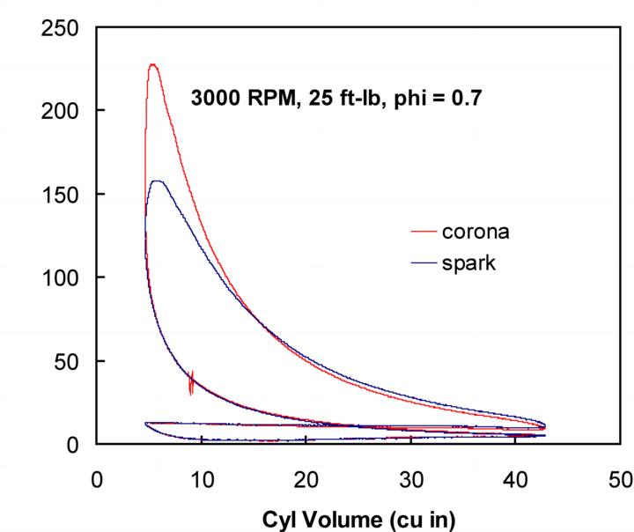
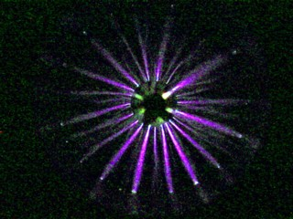

Heat transfer - mini-catechism
How can we decrease h?
Heat transfer in engines is controlled by turbulence, so you need to decrease turbulence
How can you do that?
Engines are designed for high turbulence, so you could reverse-engineer the engine for lower turbulence (e.g. by avoiding swirl in the intake ports, using "anti-squish" (see lecture 4), etc.)
Why don't we do that now?
Because we need high turbulence (high u') to get fast burning
Is there any way to burn fast without turbulence?
I'm working on that; one possibility is transient plasma ignition, which produces multiple streamers of electrons, thus multiple ignition sites, for one set of electrodes
Cylinder pressure (lb/in²)

Slide 20
Slow burn
For ignition before the minimum volume (Before Top Dead Center, BTDC), P increases faster (since both compression AND burning), but same minimum volume must be reached
Burning After Top Dead Center (ATDC) leads to much lower peak P (some burning during expansion) but somewhat higher P during expansion
Red solid: BurnStart =
BurnEnd = 0
Blue dashed: BurnStart =
0.1, BurnEnd = 0.1
r = 3, γ = 1.3, f = 0.01, Q_{R} = 4.5 x 10⁷ J/kg, T_{in} = 300K, P_{in} = 1 atm, P_{exh} = 1 atm, BurnRateProfile = 1, ExhRes = FALSE, Const-v comb = TRUE, ComplExp = FALSE, h = 0, T_{wall} = 400K, η_{comp} = η_{exp} = 1

Slide 21
Slow burn
Burn starts earlier in compression process, has to go to same v, result is higher s to get same heat addition (= ∫Tds)
Difference in work: 2 triangular slivers vs. rectangle
Burning BTDC or ATDC ALWAYS leads to lower efficiency since ALWAYS lower T_{H} for same T_{L}, thus ALWAYS lower efficiency Carnot "strips"
Moderate effect on η_{th} - 0.281 (Instant burn) vs. 0.242 (slow burn) for case shown
Red solid: BurnStart =
BurnEnd = 0
Blue dashed: BurnStart =
0.1, BurnEnd = 0.1
r = 3, γ = 1.3, f = 0.01, Q_{R} = 4.5 x 10⁷ J/kg, T_{in} = 300K, P_{in} = 1 atm, P_{exh} = 1 atm, BurnRateProfile = 1, ExhRes = FALSE, Const-v comb = TRUE, ComplExp = FALSE, h = 0, T_{wall} = 400K, η_{comp} = η_{exp} = 1

Slide 22
Slow burn – impact on ideal cycle
How to minimize impact of slow burn? Ignite the mixture BTDC; while this means some mixture is burned too early, and some burns ATDC, η_{th} better than if you wait until TDC to start burning
Burn Duration ≡ BurnStart + BurnEnd
r = 8, γ = 1.3, f = 0.068, Q_{R} = 4.5 x 10⁷ J/kg, T_{in} = 300K, P_{in} = 1 atm, P_{exh} = 1 atm
ExhRes = FALSE, Const-v comb = TRUE, BurnStart = variable
BurnEnd = variable, BurnRateProfile = 0, ComplExp = FALSE, h = 0, η_{comp} = η_{exp} = 1

Slide 23
Slow burn – impact on non-ideal cycle
With ideal cycle (no heat losses, reversible compression & expansion, no exhaust residual) optimal timing ≈ symmetric (BurnStart = BurnEnd), (previous page), but with non-ideal cycle (below), better to start burning slightly later in cycle (less heat losses)
Burn Duration ≡ BurnStart + BurnEnd
r = 8, γ = 1.3, f = 0.068, Q_{R} = 4.5 x 10⁷ J/kg, T_{in} = 300K, P_{in} = 1 atm, P_{exh} = 1 atm
BurnRateProfile = 0, ExhRes = TRUE, Const-v comb = TRUE
ComplExp = FALSE, h = 0.01, η_{comp} = η_{exp} = 0.9

Slide 24
Slow burn
Rule of thumb: best efficiency when ignition timing chosen so that maximum P occurs ≈ 10˚ ATDC
This spreadsheet: for Burn Duration = 0.15, optimal "timing" is BurnStart = 0.045, BurnEnd = 0.105, more burning ATDC - consistent with real engine
Leaner mixtures: slower burning, need to advance spark more
Spark advance sounds good BUT…
  Peak temperature substantially affected - this affects NO_{x} formation greatly - high activation energy (E) and knock (next lecture …)
  Minimum peak T when BurnStart < BurnEnd, so that more burning occurs AFTER minimum volume
  "Compress then burn" leads to lower T than "burn then compress" - burn ADDS to T, compression MULTIPLIES T
  If 1 - 2 is compress, 2 - 3 is burn then
  T₂ = T₁r^{γ-1}; T₃ = T₂ + fQ_{R}/C_{v} = T₁r^{γ-1} + fQ_{R}/C_{v}
  If 1 - 2 is burn, 2 - 3 is compress then
  T₂ = T₁ + fQ_{R}/C_{v}; T₃ = T₂r^{γ-1}; = (T₁ + fQ_{R}/C_{v})r^{γ-1}
  T_{3(BurnComb)}- T_{3(CompBurn)} = (fQ_{R}/C_{v})(r^{γ-1} - 1) > 0

Slide 25
Slow burn - effect on peak cycle T
As ignition timing is "advanced" (more burning BTDC, moving to right on plot below), peak cycle T increases substantially
Temperatures are unrealistically high since model assumes constant C_{P} & C_{v}, no dissociation but the trend will be the same with “real” gases
r = 3, γ = 1.3, f = 0.068, Q_{R} = 4.5 x 10⁷ J/kg, T_{in} = 300K, P_{in} = 1 atm, P_{exh} = 1 atm
ExhRes = TRUE, Const-v comb = TRUE, BurnStart = variable, BurnEnd = variable
BurnRateProfile = 0, ComplExp = FALSE, h = 0.01, η_{comp} = η_{exp} = 0.9

Slide 26
Burn Rate Profile
For more burning at beginning of cycle (BurnRateProfile = -1), more "burn then compress," higher peak pressures
BurnRateProfile > 0 is more realistic since more mass burned late in cycle after pressure (thus density) is higher (S_{L} & S_{T} not affected much by pressure)
r = 3, γ = 1.3, f = 0.01, Q_{R} = 4.5 x 10⁷ J/kg, T_{in} = 300K, P_{in} = 1 atm, P_{exh} = 1 atm
BurnStart = 0.1, BurnEnd = 0.1, ExhRes = FALSE, Const-v comb = TRUE
ComplExp = FALSE, h = 0, T_{wall} = 400K, η_{comp} = η_{exp} = 1

Slide 27
Burn Rate Profile
Very little effect on T-s diagram - same minimum volume reached at different points in cycle
Very little effect on efficiency - 0.244 (BurnRateProfile = 1) vs. 0.241 (BurnRateProfile = -1) for this example
r = 3, γ = 1.3, f = 0.01, Q_{R} = 4.5 x 10⁷ J/kg, T_{in} = 300K, P_{in} = 1 atm, P_{exh} = 1 atm
BurnStart = 0.2, BurnEnd = 0.2, ExhRes = FALSE, Const-v comb = TRUE
ComplExp = FALSE, h = 0, T_{wall} = 400K, η_{comp} = η_{exp} = 1

Slide 28
Exhaust residual
P-V diagram very similar, P₂ - P₃ is same (but gas going through cycle has higher T)
Peak P decreases since starting at higher T₂
  P₄/P₃ = T₄/T₃ = (T₃ + fQ_{R}/C_{v})/T₃ = 1 + fQ_{R}/C_{v}T₃ = 1 + fQ_{R}/C_{v}T₂r ^{γ-1}
Red solid: Exh Res = FALSE
Blue dashed: Exh Res = TRUE
r = 3, γ = 1.3, f = 0.01, Q_{R} = 4.5 x 10⁷ J/kg, T_{in} = 300K, P_{in} = 1 atm, P_{exh} = 1 atm
ExhRes = FALSE, Const-v comb = TRUE, BurnStart = 0 or 0.05, BurnEnd = 0
BurnRateProfile = 0, ComplExp = FALSE, h = 0, T_{wall} = 400K, η_{comp} = η_{exp} = 1

Slide 29
Exhaust residual
Higher starting T & s, otherwise ideal cycle
In ideal cycle residual has no effect on η_{th} but since exhaust residual has no fuel & lower density (higher v) than fresh gas, power or BMEP is decreased (1.84 atm vs. 2.20 atm for case shown)
Red solid: Exh Res = FALSE
Blue dashed: Exh Res = TRUE
r = 3, γ = 1.3, f = 0.01, Q_{R} = 4.5 x 10⁷ J/kg, T_{in} = 300K, P_{in} = 1 atm, P_{exh} = 1 atm
ExhRes = FALSE, Const-v comb = TRUE, BurnStart = 0 or 0.05, BurnEnd = 0
BurnRateProfile = 0, ComplExp = FALSE, h = 0, T_{wall} = 400K, η_{comp} = η_{exp} = 1

Slide 30
Complete cycle, all effects included
Comparison of cycles with "realistic" operating parameters
No throttling in this example
"Spark timing" used provides maximum η_{th} for burn duration of 0.15
Much lower peak P (less than 1/2) for non-ideal cycle
Cycle efficiency: 0.464 vs. 0.293, IMEP 18.9 atm vs. 11.8 atm; BMEP 18.9 atm vs. 10.8 atm (assuming FMEP = 1 atm)
Red solid: Ideal cycle
Blue dashed: all effects
r = 8, γ = 1.3, f = 0.068, Q_{R} = 4.5 x 10⁷ J/kg, T_{in} = 300K, P_{in} = 1 atm, P_{exh} = 1 atm, Const-v comb = TRUE
BurnStart = 0 or 0.045, BurnEnd = 0 or 0.105, h = 0 or 0.01, T_{wall} = 400K, η_{comp} = η_{exp} = 0.9 or 1

Slide 31
Complete cycle, all effects included
Cycle starts at higher T & s due to exhaust residual + heating during intake
s increases during compression - irreversible and non-adiabatic
Combustion not at constant V, but eventually hits (almost) same v (slightly lower since not as much mass, thus lower v for same V)
Less ΔT in combustion and lower peak T due to heat loss & combustion not at constant volume
Red solid: Ideal cycle
Blue dashed: all effects
Just coincidence that maximum s is same for both cycles
r = 8, γ = 1.3, f = 0.068, Q_{R} = 4.5 x 10⁷ J/kg, T_{in} = 300K, P_{in} = 1 atm, P_{exh} = 1 atm, Const-v comb = TRUE
BurnStart = 0 or 0.045, BurnEnd = 0 or 0.105, h = 0 or 0.01, T_{wall} = 400K, η_{comp} = η_{exp} = 0.9 or 1

Slide 32
Friction
Does NOT appear on P-V or T-s diagram
How to measure?
  FMEP = IMEP - BMEP: measure IMEP (from P-V diagram) and BMEP (from engine work output to dynamometer); not very accurate since it’s the difference between two nearly equal noisy numbers (e.g. 10 vs. 9 atm)
  Motoring test: spin engine with electric motor, measure power needed - but firing engine has different forces/stresses, not so accurate either
  Morse test: Remove spark plug wires one at a time, measure BMEP vs. number of firing cylinders, extrapolate to zero firing cylinders, this corresponds to IMEP = 0, BMEP will be < 0, thus BMEP = -FMEP

Slide 33
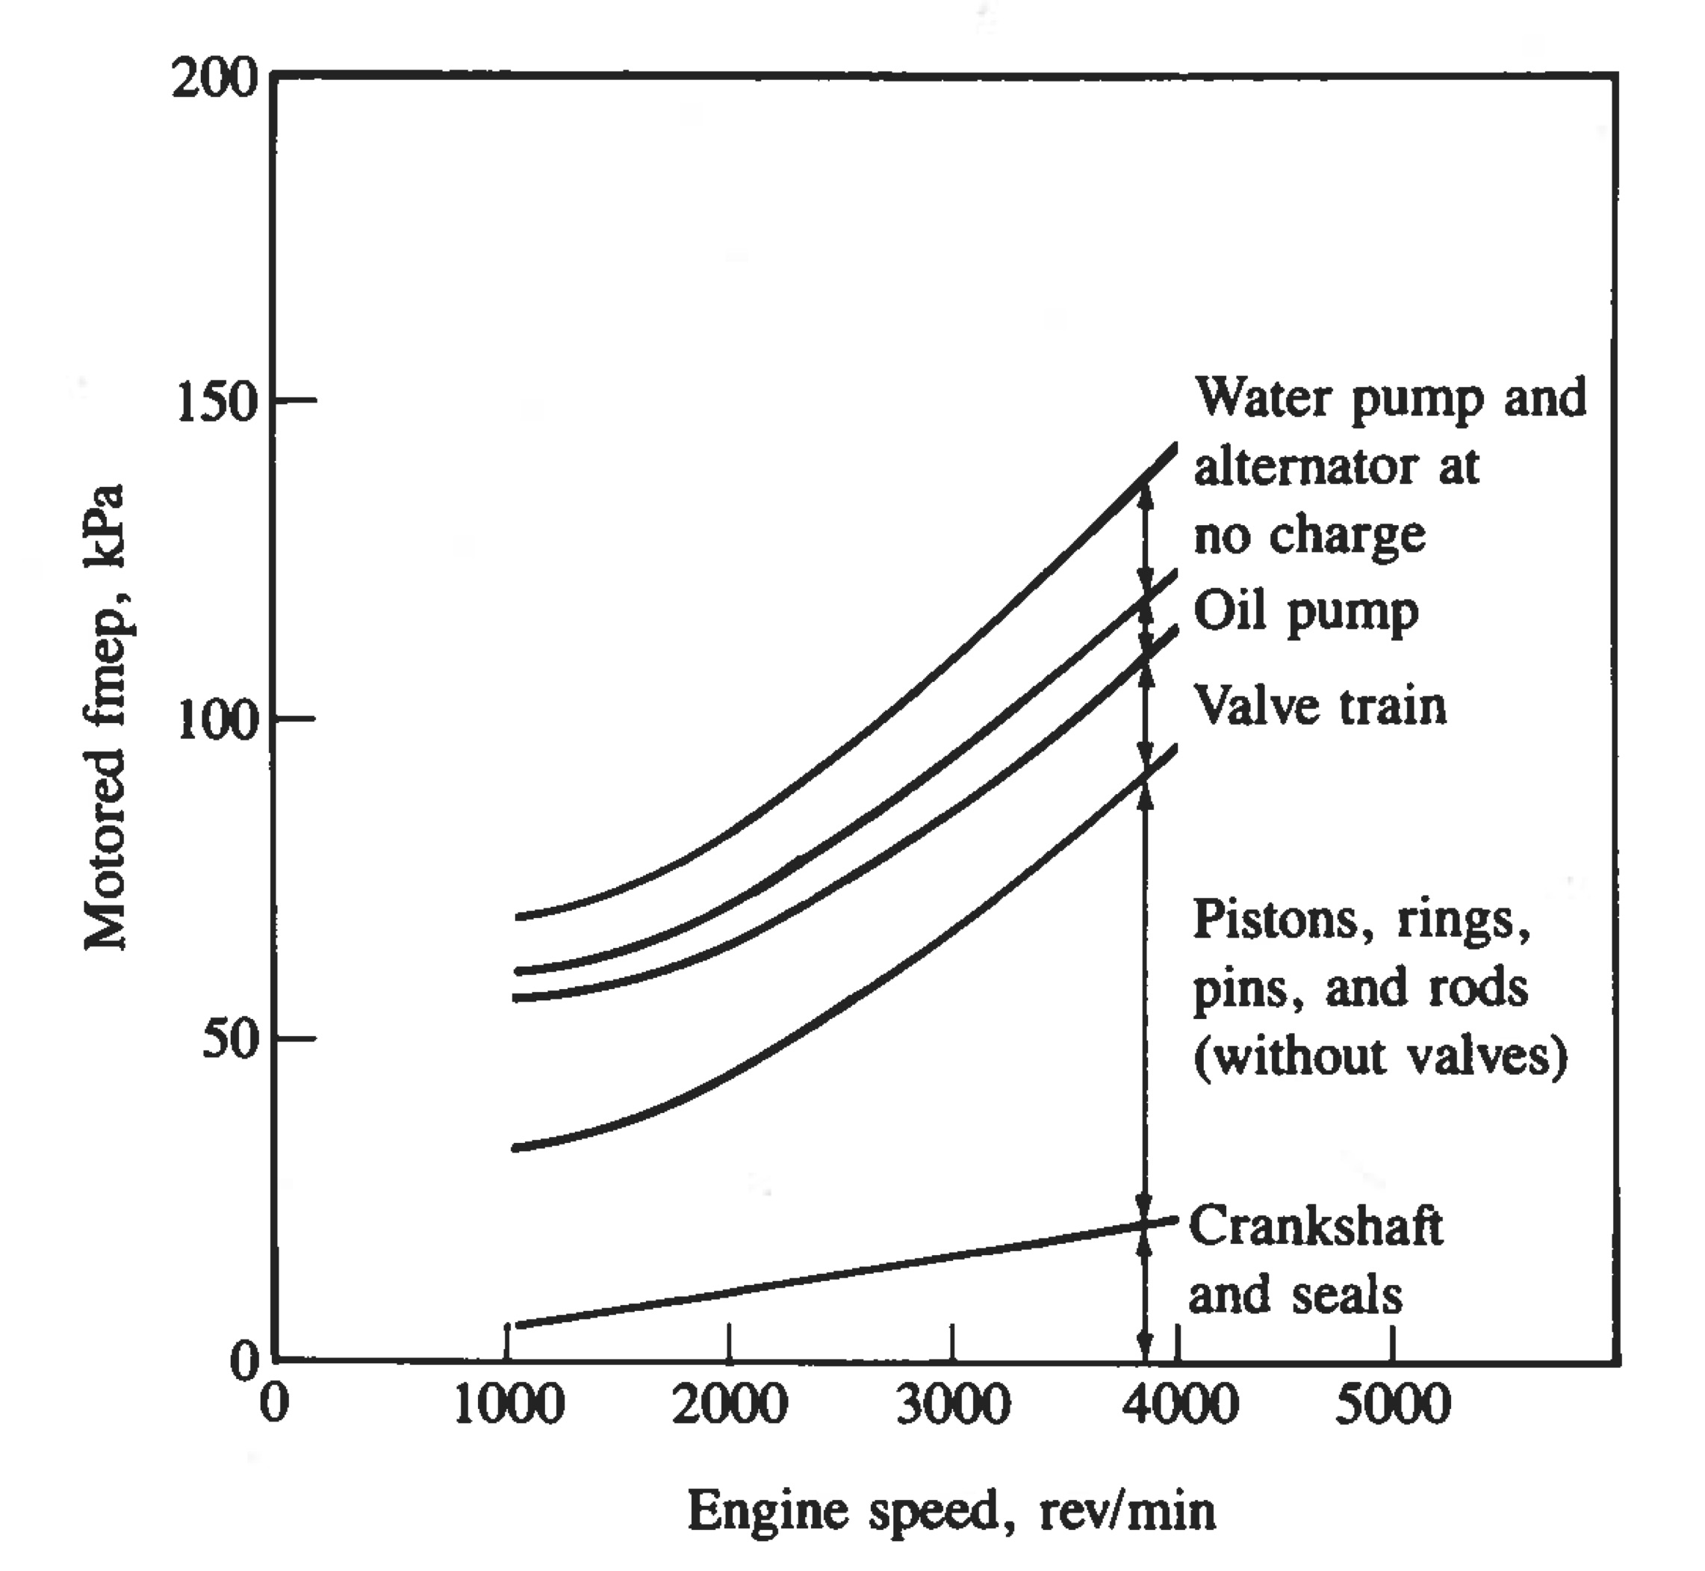
Friction
Typical result: FMEP increases roughly as N^{1/2}; since friction power = FMEP*N*V_{d} /n, friction power ~ N^{1.5}, thus at higher N, a higher % of IMEP is lost to friction (see Heywood Fig. 13-6 - 13-13)
Typical values for automotive-size engines: FMEP ≈ 1 atm at N = 500 RPM, increasing to 2.5 atm at N = 5000 RPM
Not strongly dependent on IMEP (i.e. P_{intake}) for given N
Heywood (1988)

Slide 34
Factors that limit RPM (thus power)
Mechanical strength of parts (obviously…)
Choking at valves - as N increases, mass flow ( ) needed to fill cylinder increases, but for fixed intake valve area A*, upstream pressure P_{t} and temperature T_{t}, maximum limited to (see Lecture 12)
With limited, the pressure of gas that actually gets into the cylinder (P_{cyl}) is limited:
Since IMEP ~ P_{cyl}, once this choking occurs, as N increases further, P_{cyl} and IMEP decrease
Also - as N increases, FMEP increases, IMEP decreases, so BMEP = IMEP - FMEP decreases drastically
Result: Torque = BMEP*V_{d}/2πn peaks at low N, power peaks at high N

Slide 35
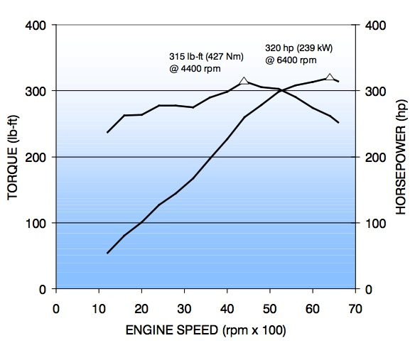
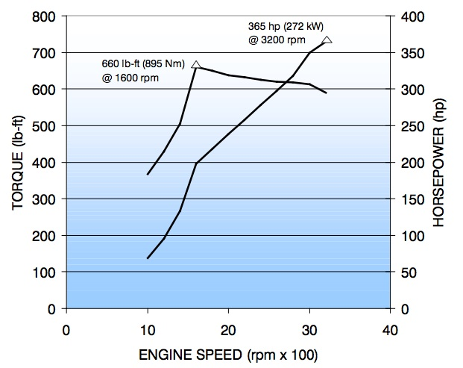
GM truck engines - gasoline vs. Diesel
Power (hp) = Torque (ft lb) x N (rev/min) ÷ 5252
Gasoline: Torque ≈ constant from 1000 to 6000 RPM; power ~ N
Turbo Diesel: Torque sharply peaked; much narrower range of usable N (1000 - 3000 RPM) (P_{intake} not reported but max. ≈ 2.3 atm from other sources
Smaller, non-turbocharged gasoline engine produces almost as much power as turbo Diesel, largely due to higher N
BMEP = 15.3 atm
BMEP = 11.5 atm
BMEP = 9.6 atm
BMEP = 16.8 atm
2010 GM Northstar 4.6 Liter V8 (LH2);
r = 10.5; variable valve timing
2010 GM Duramax 6.6 liter V8 turbocharged Diesel (LMM); r = 16.8

Slide 36
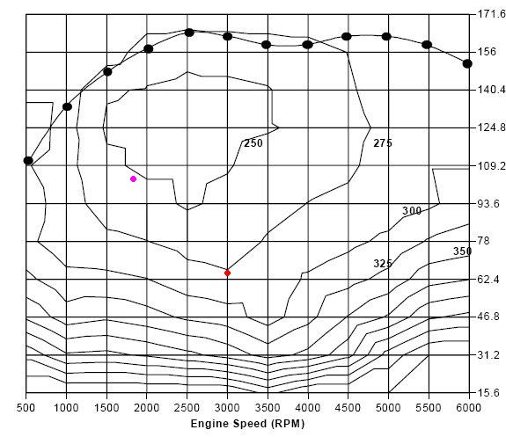
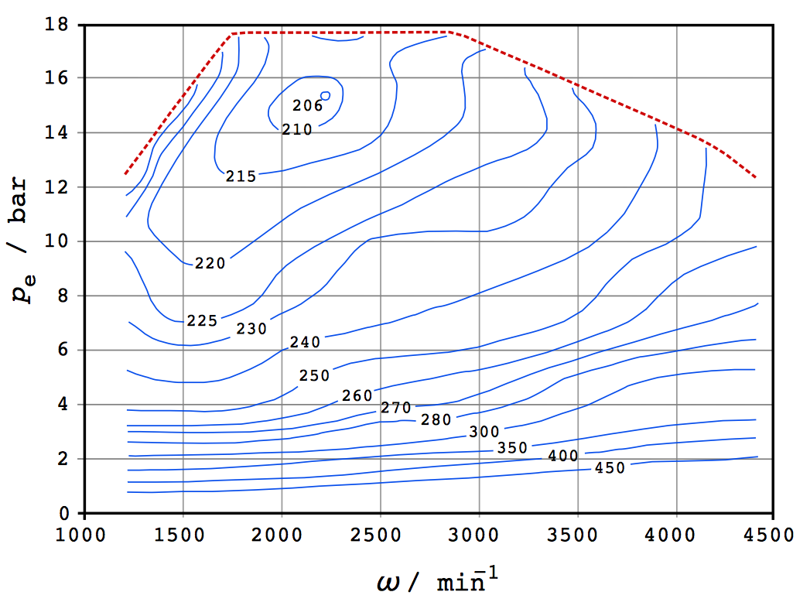
Engine fuel consumption maps
Torque (N m)
BMEP (atm)
Engine speed (RPM)
Engine speed (RPM)
4 cylinder, 1.9 liter gasoline (Saturn)
3 cylinder, 1.5 liter turbo Diesel
Fuel consumption maps in units of g/kW-hr (Max η_{th} ≈ 40.6% Diesel)
BMEP = 4π(Torque)/V_{d}; Max. BMEP for gasoline engine shown ≈ 10.4 atm)
Gasoline: torque controlled by throttling; Diesel: BMEP controlled by fuel flow
Top curve = wide open throttle (gasoline) or max. φ without major sooting (Diesel)
Max Diesel efficiency ≈ 25% higher than max. gasoline efficiency
Best efficiency at lower RPM - less FMEP
For fixed RPM, best efficiency at high load - less throttling loss (gasoline), IMEP higher relative to FMEP (both)

Slide 37
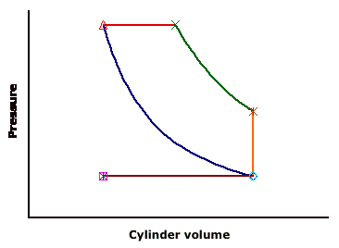
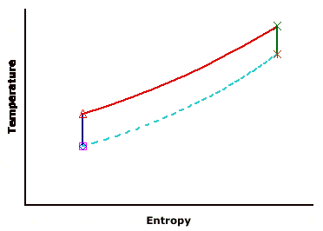
Examples - P-V & T-s diagrams
For the ideal Diesel cycle, sketch modified P-V & T-s diagrams if the following changes are made. The initial T & P, r, f, Q_{R} etc. are unchanged unless otherwise stated.
The cooling system fails so that the cylinder wall temperature becomes very high and there is heat transfer from the wall to the gas throughout the cycle
Heat transfer results in higher T & P during compression, with more total heat addition. During expansion P drops more slowly than an adiabatic curve. Due to heat addition T₃, T₄, T₅ is higher than in the original cycle.
4'
3'
4'
4
3
4
5'
5
5'
3'
5
3
2, 2'
1
2, 2'

Slide 38
Examples - P-V & T-s diagrams
(b) The fuel injector malfunctions and injects half of the fuel half way through the compression stroke; this part of the fuel burns instantaneously but the other half is still injected at the minimum cylinder volume and burns at constant P.
Constant V (partial) combustion then compression will result in higher T₃ & P₃
Total heat release is the same, so areas under T-s are the same. Since T₃’’’ is higher and fQ_{R} is lower for the constant-P part of the burn, β decreases:
3'''
4'
4'
P
4
3
4
3'''
5
v
3''
3''
5'
5
3
v
3'
5'
3'
2, 2'
1
2, 2'

Slide 39
Example - numerical
For an Otto cycle with r = 9, γ = 1.3, M = 0.029 kg/mole, f = 0.062, Q_{R} = 4.3 x 10⁷ J/kg, T₂ = 300K, P₂ = P_{in} = 0.5 atm, P₆ = P_{ex} = 1 atm, h = 0, η_{comp} = η_{exp} = 0.9, determine the following:
T & P after compression and compression work per kg of mixture
Temperature (T₄) and pressure (P₄) after combustion

Slide 40
Example - numerical - continued
Temperature (T₅) and pressure (P₅) after expansion, and the expansion work per kg of mixture
Net work per kg of mixture (don't forget about the throttling loss!)

Slide 41
Example - numerical - concluded
Thermal efficiency
IMEP
Temperature of exhaust gas after blowdown

Slide 42
Summary
"Real" cycles differ from ideal cycles in ways that significantly affect performance predictions
  Irreversible compression/expansion lowers η
    More ΔT (thus more work) during compression
    Less ΔT (thus less work) during expansion
  Heat transfer to gas during cycle - sounds good, but it takes more work to compress a hot gas than a cold gas, lowers η!
  Finite burn time
    Best η when burning occurs at min. v or max. P ⇒ max. T
  Exhaust residual - hot exhaust gas mixing with fresh intake gas decreases ρ (increases specific volume v = 1/ρ) decreasing power (though not necessarily η)
  Friction – doesn’t affect states of gas, but affects net Power & η
Since engines are essentially air processors, any factor that limits air flow limits power

