Slide 1

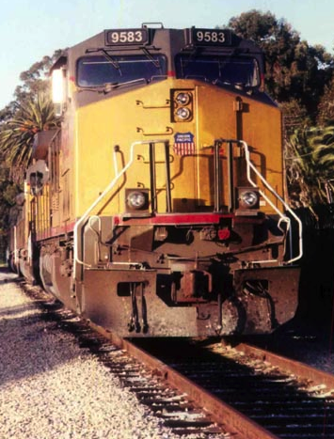
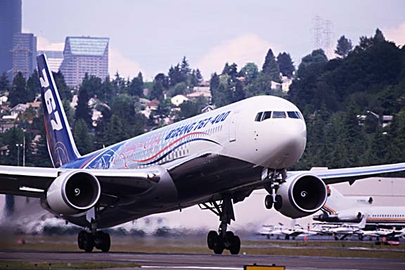
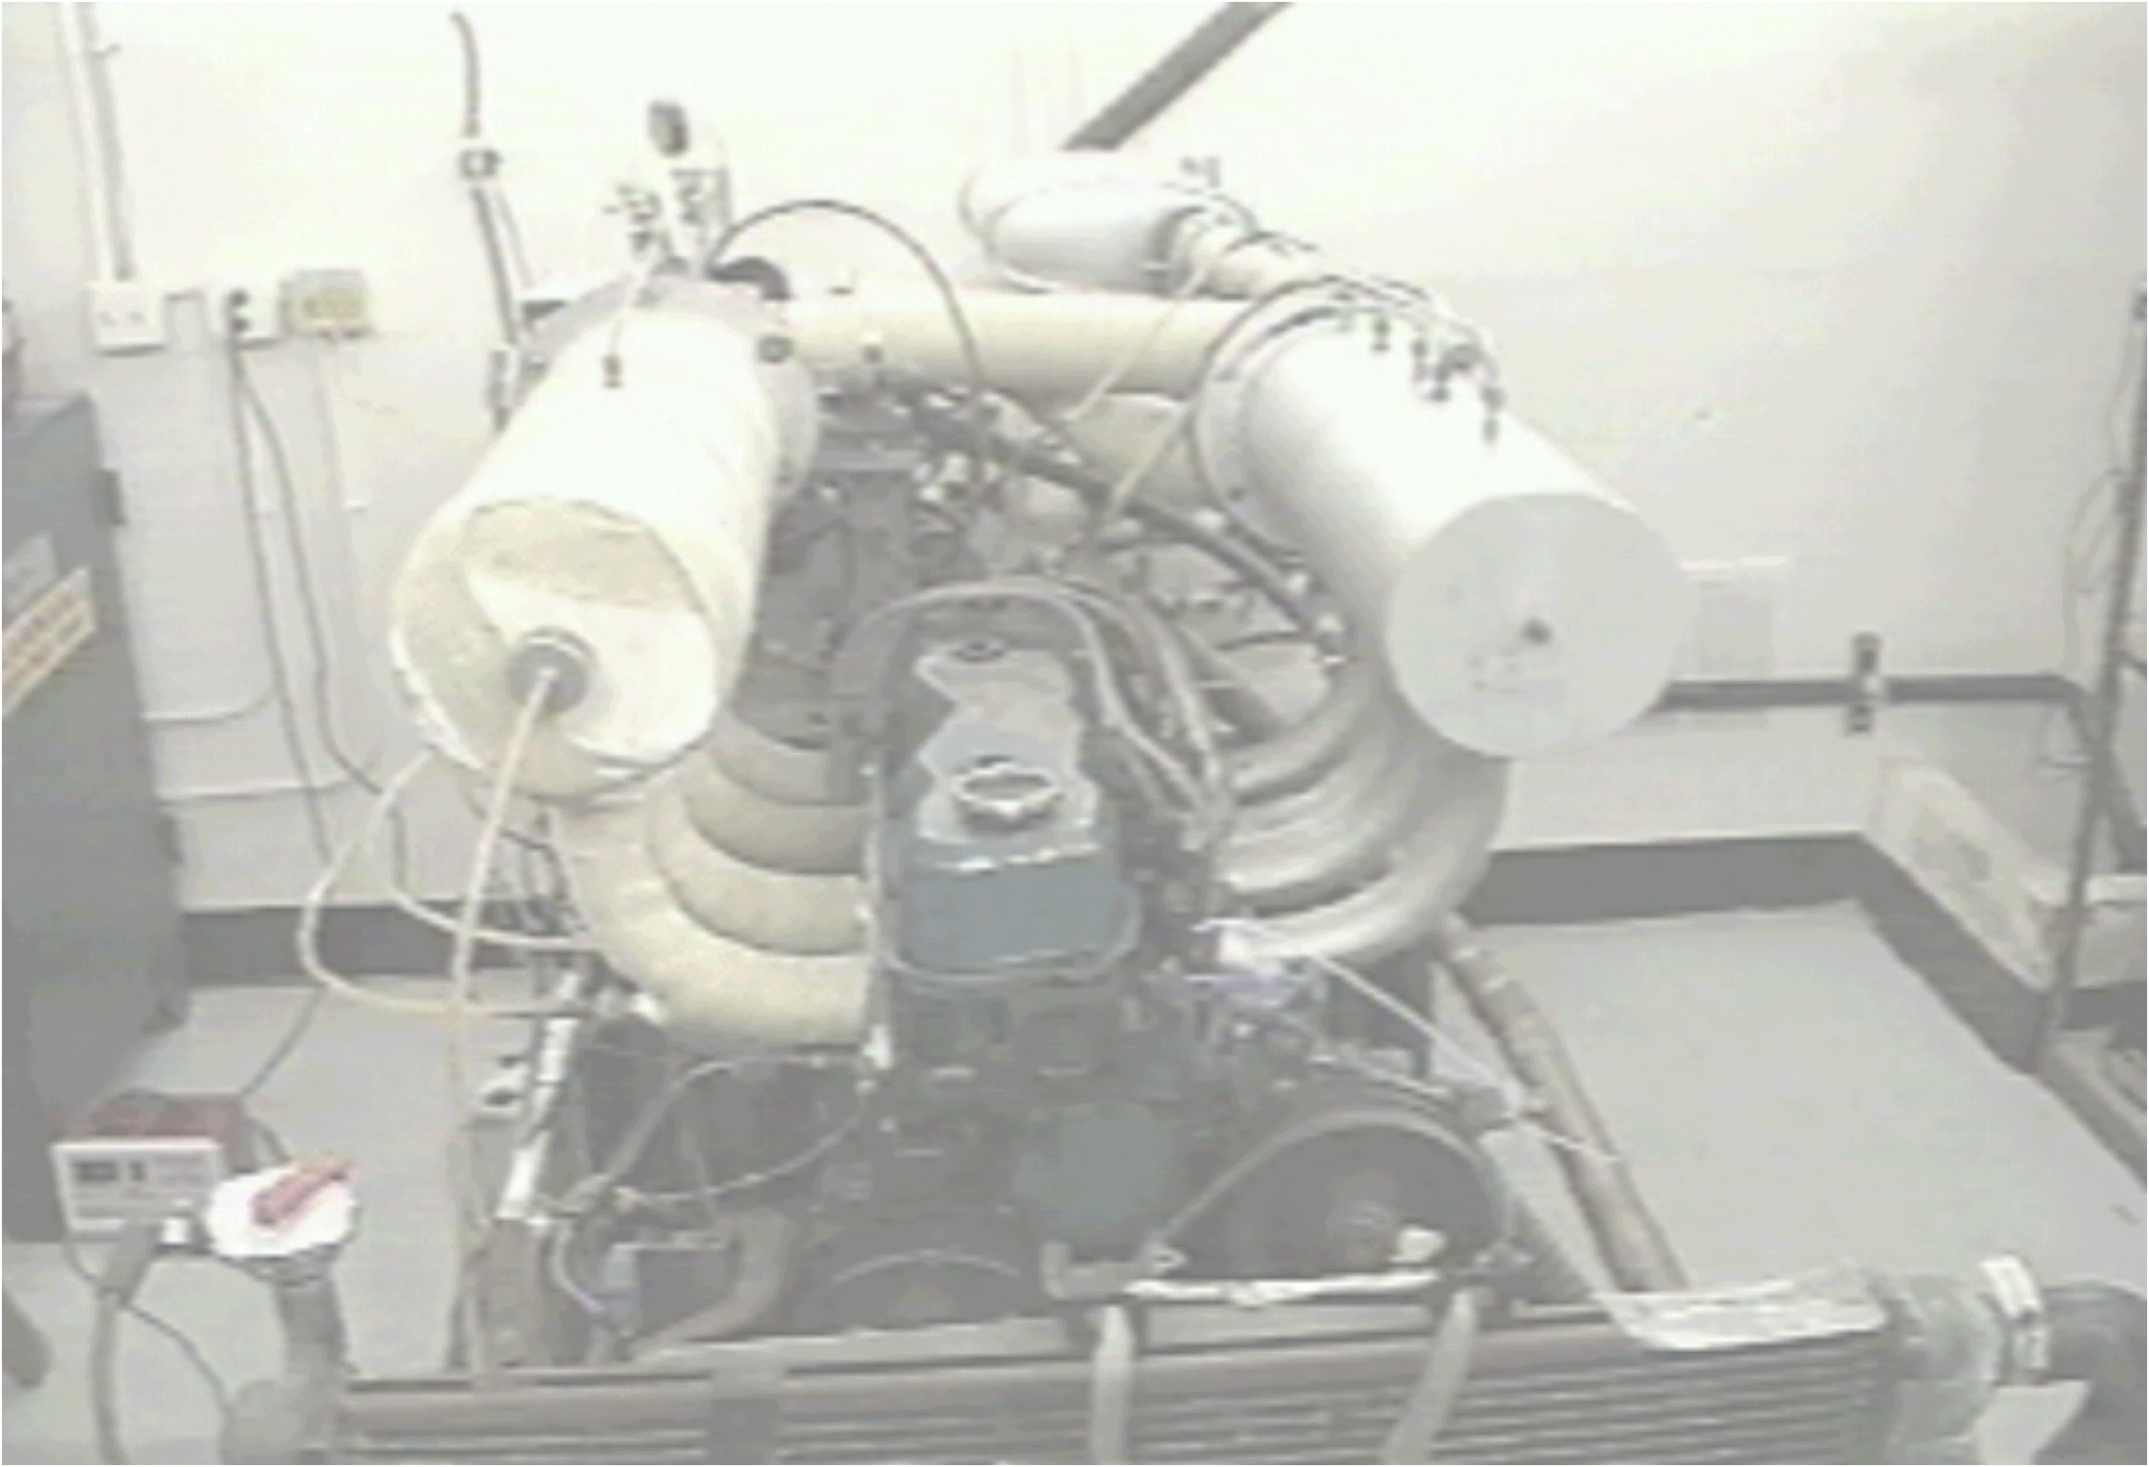

AME 436
Energy and Propulsion
Lecture 6
Unsteady-flow (reciprocating) engines 1:
Basic operating principles,
design & performance parameters

Slide 2
Outline
Classification of unsteady-flow engines
Basic operating principles
  Premixed-charge (gasoline) 4-stroke
  Premixed-charge (gasoline) 2-stroke
  Premixed-charge (gasoline) rotary or Wankel
  Nonpremixed-charge (Diesel) 4-stroke
  Nonpremixed-charge (Diesel) 2-stroke
Design and performance parameters
  Compression ratio, displacement, bore, stroke
  Power, torque, work, Mean Effective Pressure
  Thermal efficiency
  Volumetric efficiency
  Emissions

Slide 3
Classification of unsteady-flow engines
Most important distinction: premixed-charge vs. nonpremixed-charge
Premixed-charge: frequently called "Otto cycle," "gasoline" or "spark ignition" engine but most important distinction is that the fuel and air are mixed before or during the compression process and a premixed flame is ignited (usually by spark)
Nonpremixed-charge: frequently called "Diesel" or "compression ignition" but key point is that only air is compressed (not fuel-air mixture) & fuel is injected into combustion chamber after air is compressed
Either premixed or nonpremixed-charge can be 2-stroke or 4-stroke, and can be piston/cylinder type or rotary (Wankel) type

Slide 4
Classification of unsteady-flow engines
Why is premixed-charge (typically gasoline) vs. nonpremixed-charge (typically Diesel) the most important distinction? Because it affects
  Choice of fuels and ignition system
  Choice of compression ratio (nonpremixed: higher, no knocking)
  Tradeoff between maximum power (premixed) and efficiency
  (nonpremixed, higher compression)
  Relative amounts of
  pollutant formation
  (premixed: generally lower
  NO_{x} & particulates;
  nonpremixed: lower CO &
  UHC)

Slide 5
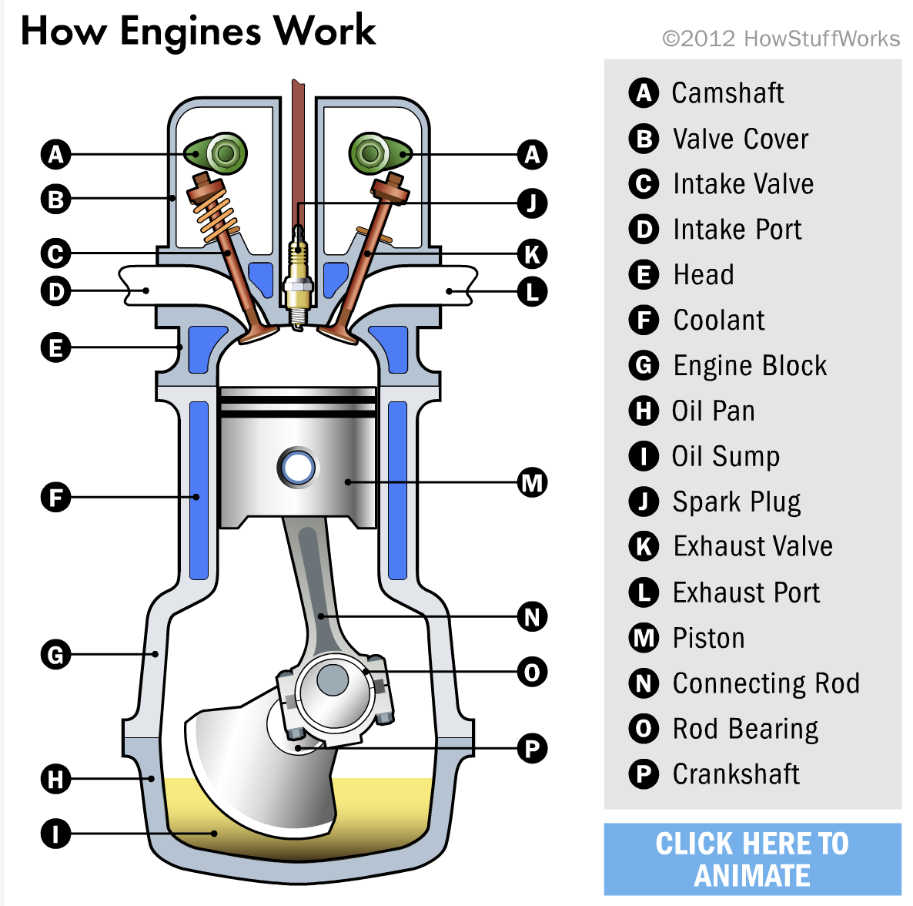
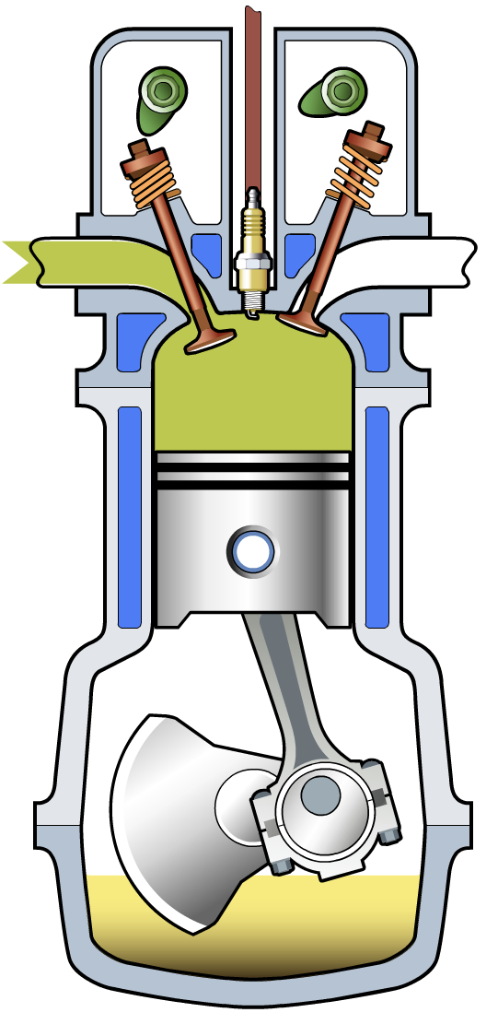
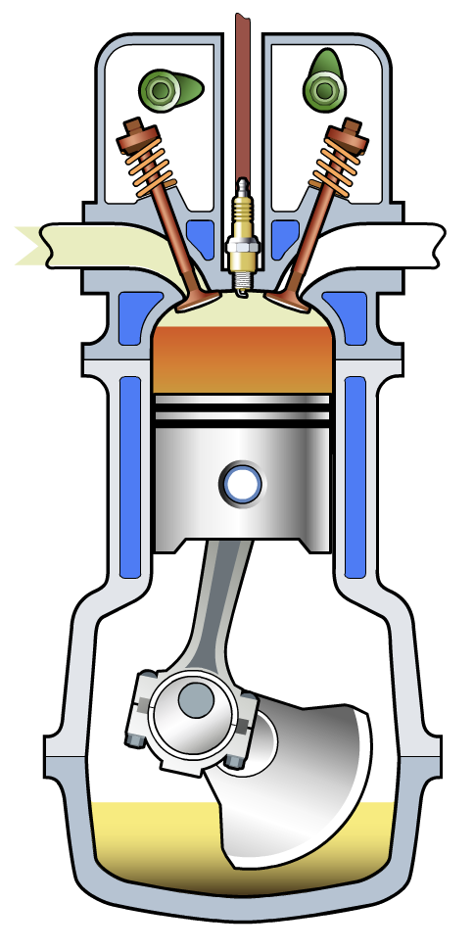
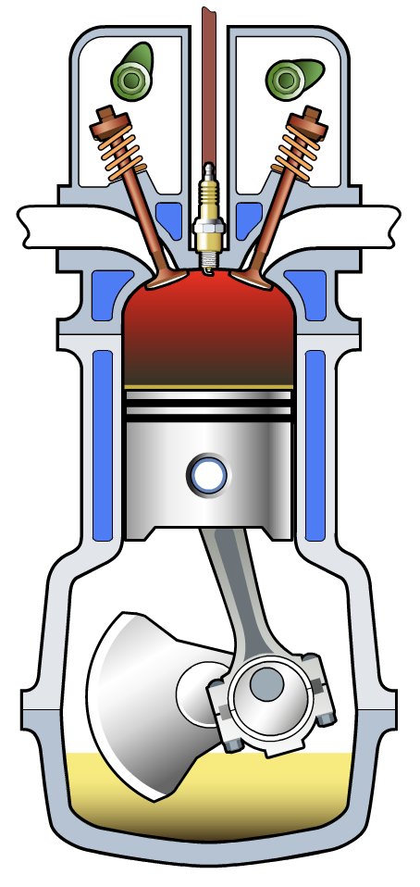
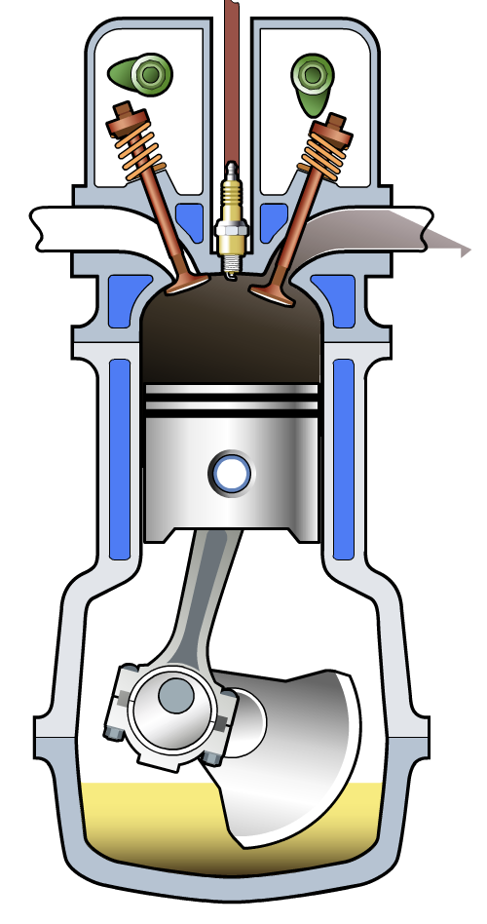
4-stroke premixed-charge piston engine
Animation: https://auto.howstuffworks.com/engine1.htm
    Ideally combustion occurs in zero time when piston is at the top of its travel between the compression and expansion strokes
Intake (piston moving down, intake valve open, exhaust valve closed)
Compression (piston moving up, both valves closed)
Expansion (piston moving down, both valves closed)
Exhaust (piston moving up, intake valve closed, exhaust valve open)

Slide 6
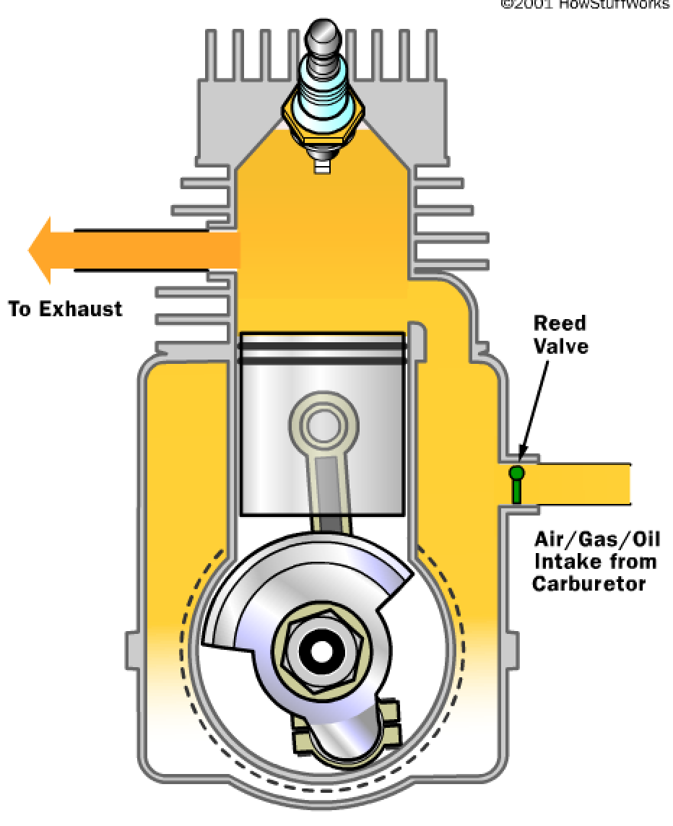
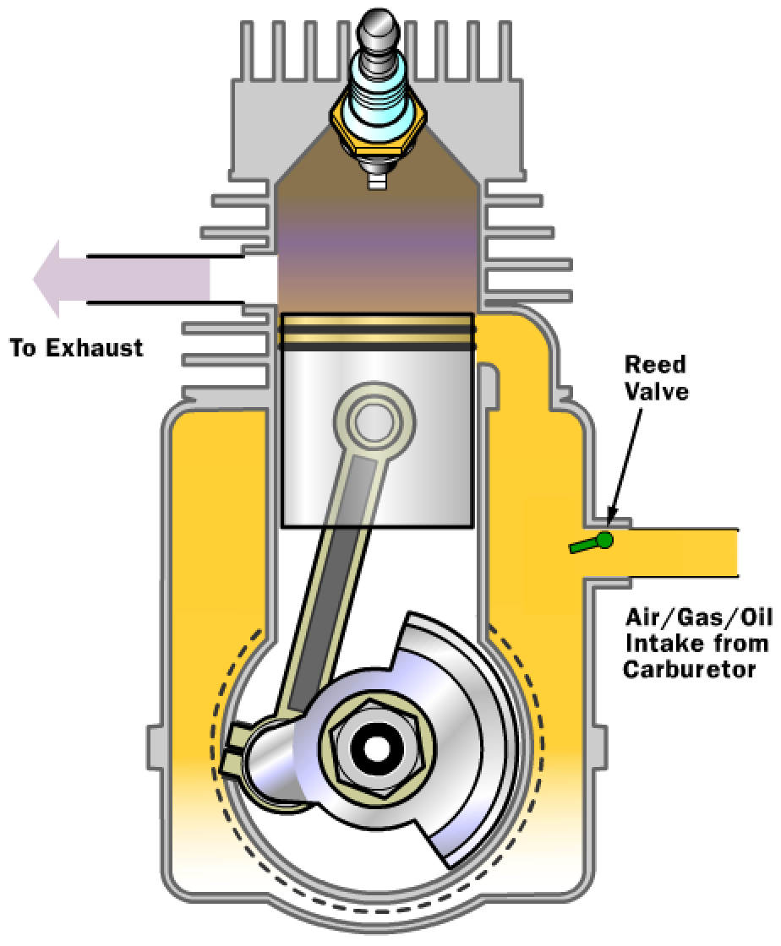
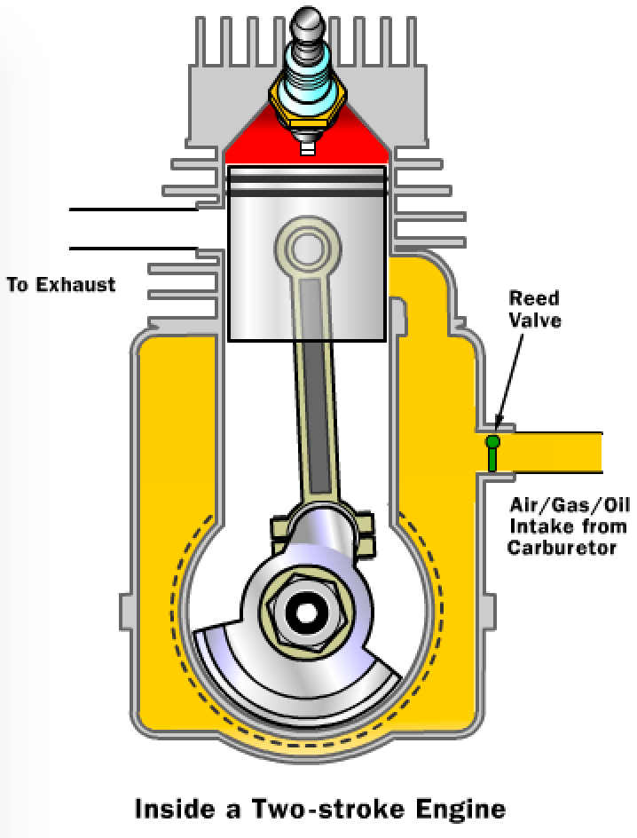
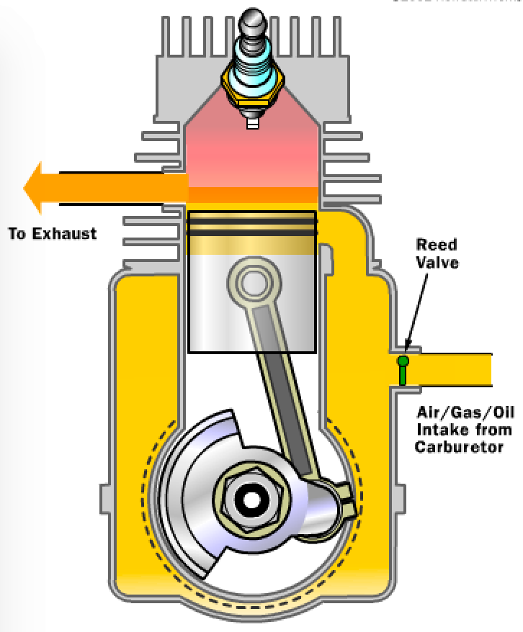
2-stroke premixed-charge piston engine
Animation: https://science.howstuffworks.com/transport/engines-equipment/two-stroke2.htm
Scavenging exhaust & filling comb. chamber (piston moving down, reed valve closed, intake & exhaust ports uncovered)
Filling crankcase (piston moving up, reed valve open, intake port closed, exhaust port open)
Expansion (piston moving down, both ports covered)
Exhaust & crankcase compression (piston moving down, intake port closed, exhaust port open)

Slide 7
2-stroke premixed-charge engine
Most designs have fuel-air mixture flowing first INTO CRANKCASE (?)
Fuel-air mixture must contain lubricating oil
2-strokes gives ≈ 2x as much power since only 1 crankshaft revolution needed for 1 complete cycle (vs. 2 revolutions for 4-strokes)
Since intake & exhaust ports are open at same time, some fuel-air mixture flows directly out exhaust & some exhaust gas gets mixed with fresh gas
Since oil must be mixed with fuel, oil gets burned
As a result of these factors, thermal efficiency is lower, emissions are higher, and performance is near-optimal for a narrower range of engine speeds compared to 4-stroke engines

Slide 8
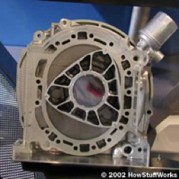
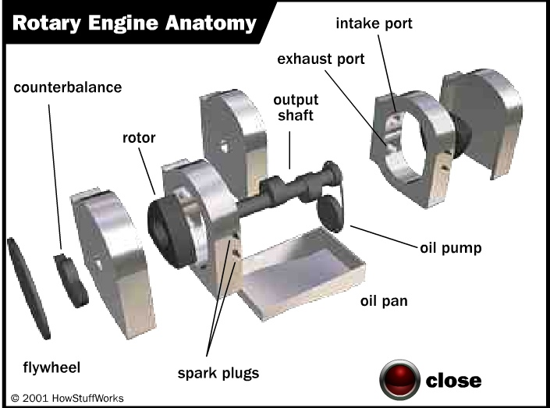
Rotary or Wankel engine
Uses non-cylindrical combustion chamber
One complete cycle per engine revolution without "short circuit" flow of 2-strokes
Simpler, fewer moving parts, higher RPM possible
Very fuel-flexible, e.g. can incorporate catalyst in combustion chamber since fresh gas is moved into chamber rather than being continually exposed to it (as in piston engine) – one engine could use gasoline, Diesel, methanol, etc.
Difficult to seal BOTH vertices & flat sides of rotor! - seal longevity a problem too
Large surface area to volume ratio means more heat losses
http://static.howstuffworks.com/flash/rotary-engine-exploded.swf

Slide 9
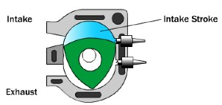
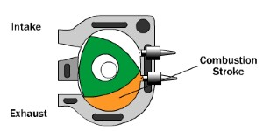
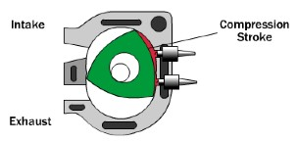
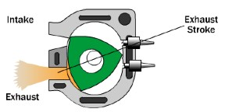
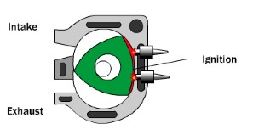
Rotary or Wankel engine
http://auto.howstuffworks.com/rotary-engine4.htm

Slide 10
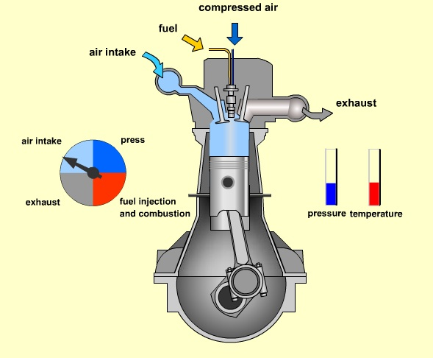
4-stroke Diesel engine
Conceptually similar to 4-stroke gasoline, but only air is compressed (not fuel-air mixture) and fuel is injected into combustion chamber after air is compressed
http://auto.howstuffworks.com/diesel1.htm

Slide 11
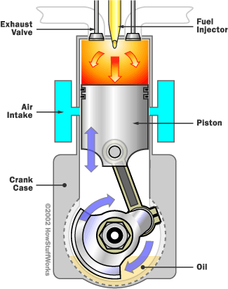
2-stroke Diesel engine
Used in large engines, e.g. locomotives
More differences between 2-stroke gasoline vs. diesel engines than 4-stroke gasoline vs. diesel
  Air comes in directly through intake ports, not via crankcase
  Must be turbocharged or supercharged to provide pressure to force air into cylinder
  No oil mixed with air - crankcase has lubrication like 4-stroke
  Exhaust valves rather than ports - not necessary to have intake & exhaust paths open at same time
  Because only air, not fuel/air mixture enters through intake ports, "short circuit" of intake gas out to exhaust not a problem
  Because of the previous 3 points, 2-stroke diesels have far fewer environmental problems than 2-stroke gasoline engines
auto.howstuffworks.com/diesel-two-stroke1.htm

Slide 12
Engine design & performance parameters
Compression ratio (r_{c})
  V_{d} = displacement volume = volume of cylinder swept by piston
  V_{c} = clearance volume = volume of cylinder NOT swept by piston
Bore (B) = cylinder diameter
Stroke (L) = distance between maximum excursions of piston
Displacement volume of 1 cylinder = πB²L/4; if B = L (typical), 5.7 liter, 8-cylinder engine, B = 9.7 cm
Power = Angular speed (N) x Torque (τ) = 2πNτ

Slide 13
Classification of unsteady-flow engines

Slide 14
Engine design & performance parameters
Engine performance is specified in both in terms of power and engine torque - which is more important?
  Wheel torque = engine torque x gear ratio tells you whether you can climb the hill
  Gear ratio in transmission typically 3:1 or 4:1 in 1st gear, 1:1 in highest gear; gear ratio in differential typically 3:1
    Ratio of engine revolutions to wheel revolutions varies from 12:1 in lowest gear to 3:1 in highest gear
  Power tells you how fast you can climb the hill
  Torque can be increased by transmission (e.g. 2:1 gear ratio ideally multiplies torque by 2)
  Power can't be increased by transmission; because of friction, power will decrease in transmission
  Power tells you how fast you can accelerate or how fast you can climb a hill, but power to torque ratio ~ N tells you what gear ratios you'll need to do the job

Slide 15
Engine design & performance parameters
Indicated work - work done for one cycle as determined by the cylinder P-V diagram = work acting on piston face
Net indicated work = W_{i,net} = ∫ PdV over whole cycle = net area inside P-V diagram
Indicated work consists of 2 parts
  Gross indicated work W_{i,gross} - work done during power cycle
  Pumping work W_{i,p} - work done during intake/exhaust pumping cycle
W_{i.net} = W_{i,gross} - W_{i,pump}
Indicated power = W_{i,x}N/n, where x could be net, gross or pumping and n = 2 for 4-stroke engine, n = 1 for 2 stroke engine (4-stroke needs 2 engine revs for a complete cycle, 2-stroke only 1 rev)
Brake work (W_{b}) or brake power (P_{b}) = work or power at the shaft coming out of the engine
What's the difference between brake & indicated work? FRICTION
  W_{i,g} = W_{b} + W_{f} + W_{i.p}; W_{f} = friction work
  W_{f} also includes work to drive cooling fan, water & oil pumps, generator, air conditioner, …

Slide 16
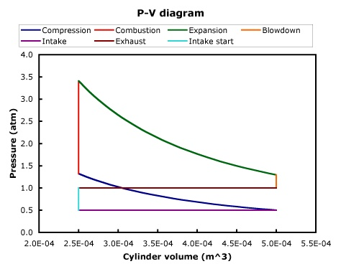
Engine design & performance parameters
Animation: gross & net indicated work, pumping work
Net indicated work
(+)
Gross indicated work
(-)
Pumping work

Slide 17
Real engine P-V diagram
Clearance volume
Displacement volume
Expansion stroke
Compression stroke
Exhaust pressure ≈ 1 atm
Exhaust stroke
Intake pressure ≈ 0.3 atm
Intake stroke

Slide 18
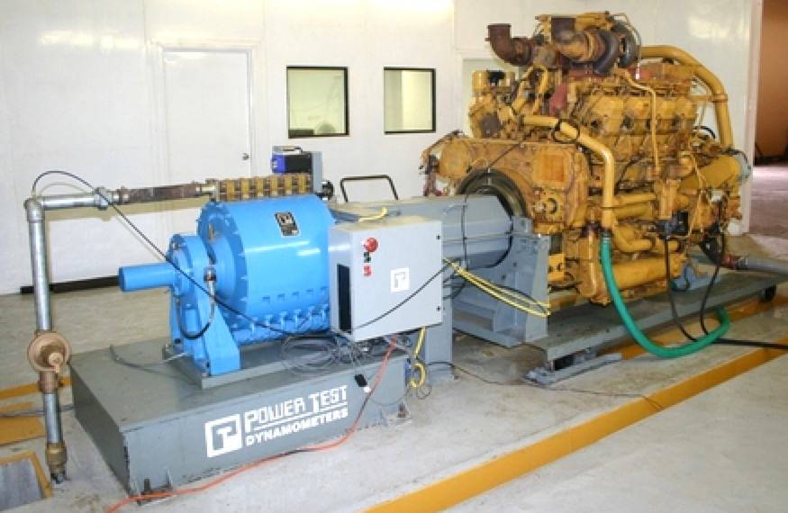
Indicated vs. brake work or power
Indicated
  Measure cylinder P vs. time
  Measure crank angle vs. time
  Translate crank angle to volume (V) with engine geometry (piston / crankshaft / connecting rod)
  Plot P vs. V
  ∫ PdV = indicated work (W_{ind})
  Power = W_{ind}N/n
Brake
  Connect engine to dynamometer (e.g., electrical generator) to simulate load that vehicle puts on engine
  Measure torque required to spin generator at a particular speed (N)
  Power = Torque x N / 5252
  (when Power in hp, Torque in ft lbf
  and N in rev/min)

Slide 19
Engine design & performance parameters
Mechanical efficiency - measure of importance of friction loss
= (brake work or power) / (indicated work or power)
Thermal efficiency (η_{th}) = (what you get / what you pay for) = (power ouput) / (fuel heating value input)
Specific fuel consumption (i = indicated, b = brake)
  units usually pounds of fuel per horsepower-hour (yuk!)
Combining the above definitions

Slide 20
Engine design & performance parameters
Volumetric efficiency (η_{v}) = (mass of air actually drawn into cylinder) / (mass of air that ideally could be drawn into cylinder)
where ρ_{air} is at ambient conditions = P_{ambient}/RT_{ambient}
Volumetric efficiency indicates how well the engine "breathes" - what lowers η_{v} below 100%?
  Throttling (intentional pressure drop with a valve to reduce air mass flow, thus power)
  (Undesired) pressure drops in intake manifold & intake valves
  (Undesired) temperature rise due to heating of air in intake system
  Volume occupied by fuel
  Non-ideal valve timing
  "Choking" (air flow reaching speed of sound) in part of intake system having smallest area (passing intake valves)
Will be > 100% with turbocharging or supercharging
See Heywood (2nd ed., p. 228) for good summary of these effects

Slide 21
Engine design & performance parameters
Mean effective pressure (MEP)
Power could be brake, indicated, friction or pumping power, leading to BMEP, IMEP, FMEP, PMEP
Note Power = Torque x 2πN, thus
MEP is useful for 2 reasons
  Since it's proportional to power or work, we can add and subtract pressures just like power or work
  (More important) it normalizes out the effects of engine size (V_{d}), speed (N) and 2-stroke vs. 4-stroke (n) – parameter for comparing different engines and operating conditions
Typical 4-stroke engine, IMEP ≈ 120 lb/in² ≈ 10 atm - how to get more? Turbocharge - increase P_{intake} above 1 atm, more fuel & air stuffed into cylinder, more heat release, more power

Slide 22
Engine design & performance parameters
MEP is useful for 2 reasons
  Since it's proportional to power or work, we can add and subtract pressures just like power or work
  (More important) it normalizes out the effects of engine size (V_{d}), speed (N) and 2-stroke vs. 4-stroke (n) – parameter for comparing different engines and operating conditions
Typical 4-stroke engine, IMEP ≈ 150 lb/in² ≈ 10 atm - how to get more? Turbocharge - increase P_{intake} above 1 atm, more fuel & air stuffed into cylinder, more heat release, more power

Slide 23
Engine design & performance parameters
Pumping power = (pumping work)(N)/n = (ΔP)(ΔV)(N)/n
= (P_{exhaust} - P_{intake})V_{d}N/n
but PMEP = (pumping power)n/(V_{d}N), thus PMEP = (P_{exhaust} - P_{intake})
(wasn't that easy?) (this assumes "pumping loop" is a rectangle)
Estimate of IMEP
Typical engine at wide-open throttle (P_{intake} = P_{ambient}):
η_{th,i,g} ≈ 35%, η_{v} ≈ 90%, f ≈ 0.0641 (at stoichiometric),
Q_{R} = 4.3 x 10⁷ J/kg, R = 287 J/kgK, T_{intake} = 300K
⇒ IMEP_{g} / P_{intake} ≈ 10.1

Slide 24
Example #1
Estimate the brake power of a 5.7 liter (= 0.0057 m³) 4-stroke (n = 2) engine at 6000 RPM with brake thermal efficiency η_{th,b} = 30% = 0.30 and volumetric efficiency η_{v} = 90% = 0.90 using a stoichiometric gasoline-air mixture (f_{stoich} = 0.0641, Q_{R} = 4.3 x 10⁷ J/kg)

Slide 25
Example #2
In a laboratory test of a 4-stroke engine with V_{d} = 3.05 liters at N = 3000 RPM the following data were measured: net IMEP 107.9 lbf/in², 70.32 brake horsepower, fuel flow rate 16.66 kg/hr, air flow rate 269.6 kg/hr. The fuel is C₈H₁₈ (Q_{R} = 4.3 x 10⁷ J/kg.) The ambient air temperature is 295K. The intake pressure gauge is broken, so the intake pressure is not known. Determine:
a) BMEP
b) Friction MEP
  FMEP = IMEP – BMEP
  IMEP = (107.9 lb/in²)(4.448N/lb)(in/0.0254m)² = 7.44 x 10⁵ N/m²
  FMEP = 7.44 x 10⁵ N/m² – 6.88 x 10⁵ N/m² = 5.6 x 10⁴ N/m² = 0.55 atm
c) Equivalence ratio
  C₈H₁₈ + 12.5(O₂ + 3.77N₂) → 8 CO₂ + 9 H₂O + 12.5(3.77) N₂
  Stoichiometric fuel/air: (8(12)+18(1))/[12.5((32)+3.77(28))] = 0.0663
  Actual fuel/air: (16.66 kg/hr)/(269.6 kg/hr) = 0.06179
  Equivalence ratio = 0.06179/0.0663 = 0.932

Slide 26
Example #2 (continued)
d) Brake thermal efficiency
e) Indicated torque
f) Is this engine throttled, turbocharged or neither? Explain. (Hint: compute the volumetric efficiency.)

Slide 27
Summary
Many mechanical implementations of unsteady-flow engines exist, but all are based on a thermodynamic cycle consisting of compression, combustion, expansion
The factor that affects engine design and performance more than any other is whether the engine is premixed-charge or nonpremixed-charge
Because of different fueling & exhaust scavenging methods, each type of engine (premixed vs. nonpremixed-charge, 2-stroke vs 4-stroke) is optimal for a different application
Many measures of engine performance are employed - be careful!
  Work and power – indicated (gross or net) vs. brake
  Efficiencies - thermal vs. volumetric
  Mean Effective Pressure - brake, indicated, pumping, friction

