Slide 1

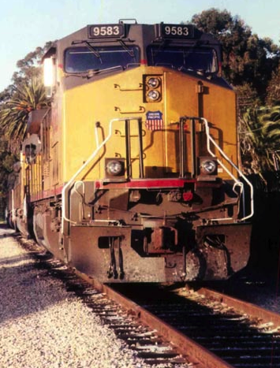
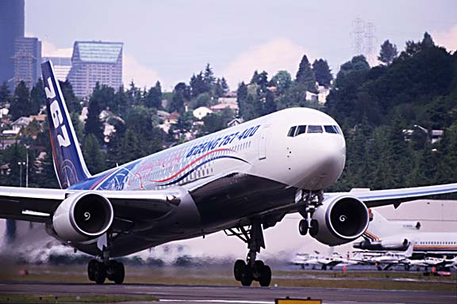
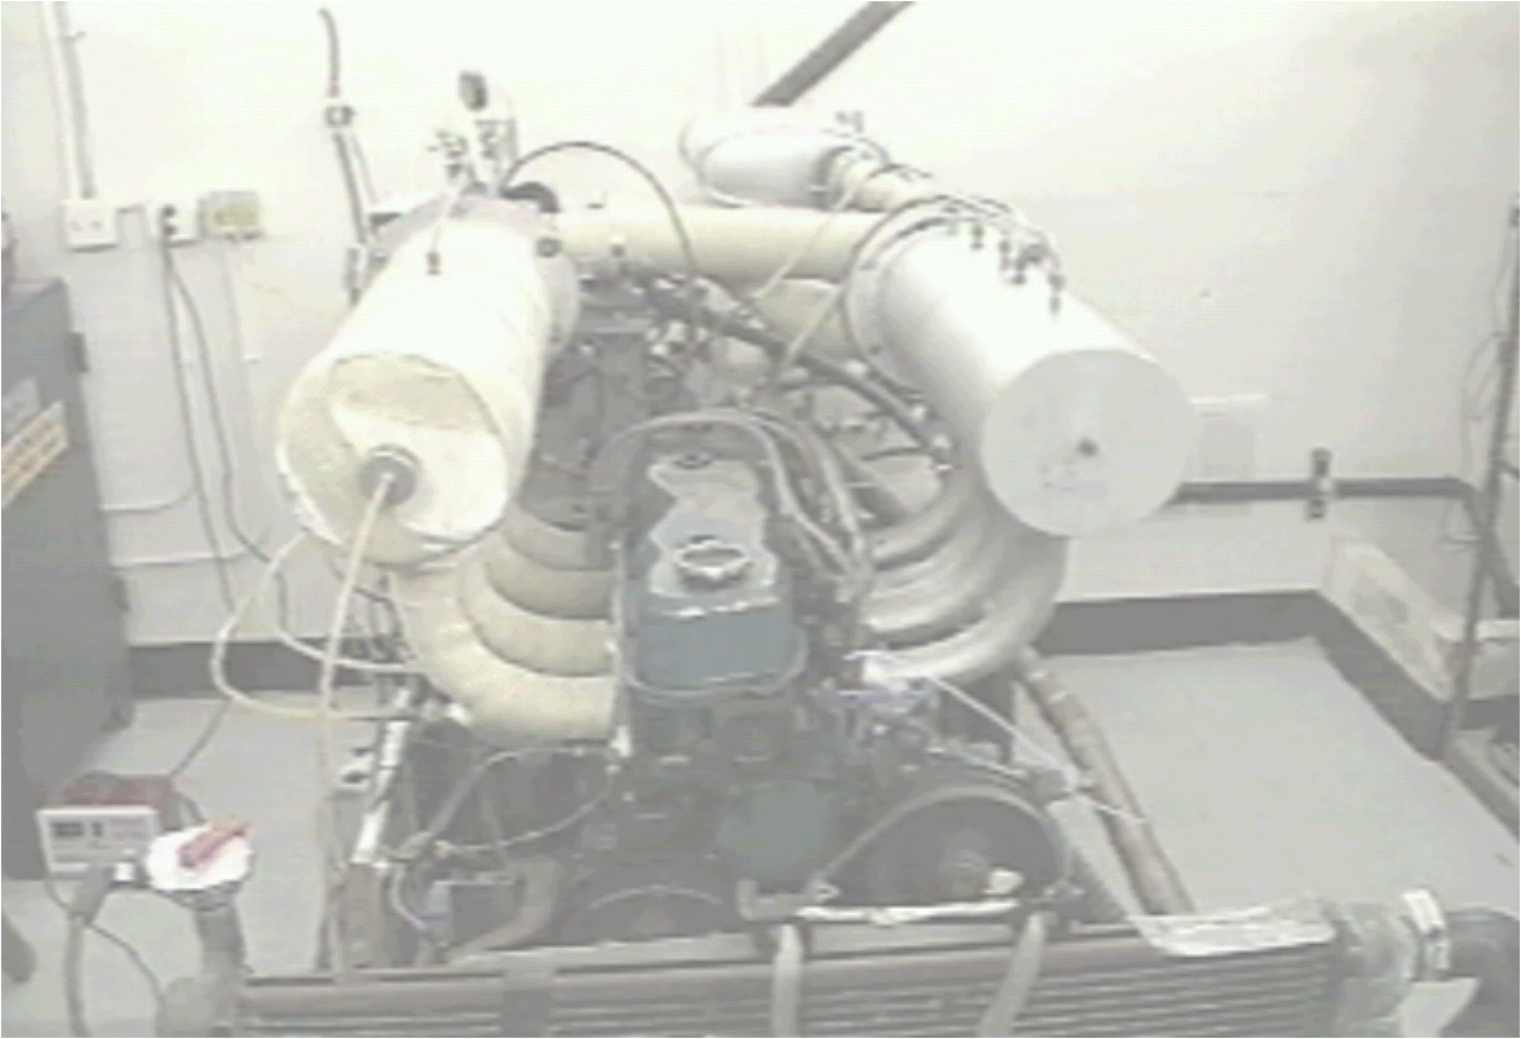

AME 436
Energy and Propulsion
Lecture 11
Propulsion 1: Thrust and aircraft range

Slide 2
Outline
Why gas turbines?
Computation of thrust
Propulsive, thermal and overall efficiency
Specific thrust, thrust specific fuel consumption, specific impulse
Breguet range equation

Slide 3
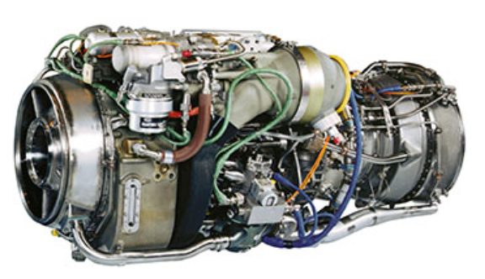
Why gas turbines?
GE CT7-8 turboshaft (used in helicopters)
https://www.geaviation.com/commercial/engines/ct7-engine
Compressor/turbine stages: 6/4
Diameter 26”, Length 48.8” = 426 liters = 5.9 hp/liter
Dry Weight 537 lb, max. power 2,634 hp (power/wt = 4.7 hp/lb)
Pressure ratio at max. power: 21 (ratio per stage = 21^{1/6} = 1.66)
Specific fuel consumption at max. power: 0.452 (units not given; if lb/hp-hr then corresponds to 29.3% efficiency)
Cummins QSK60-2850 4-stroke 60.0 liter (3,672 in³) V-16 2-stage turbocharged diesel (used in mining trucks)
https://mart.cummins.com/imagelibrary/data/assetfiles/0032422.pdf
2.93 m long x 1.58 m wide x 2.31 m high = 10,700 liters = 0.27 hp/liter
Dry weight 21,207 lb, 2850 hp at 1900 RPM (power/wt = 0.134 hp/lb = 35x lower than gas turbine)
BMEP = 22.1 atm
Volume compression ratio ??? (not given)

Slide 4
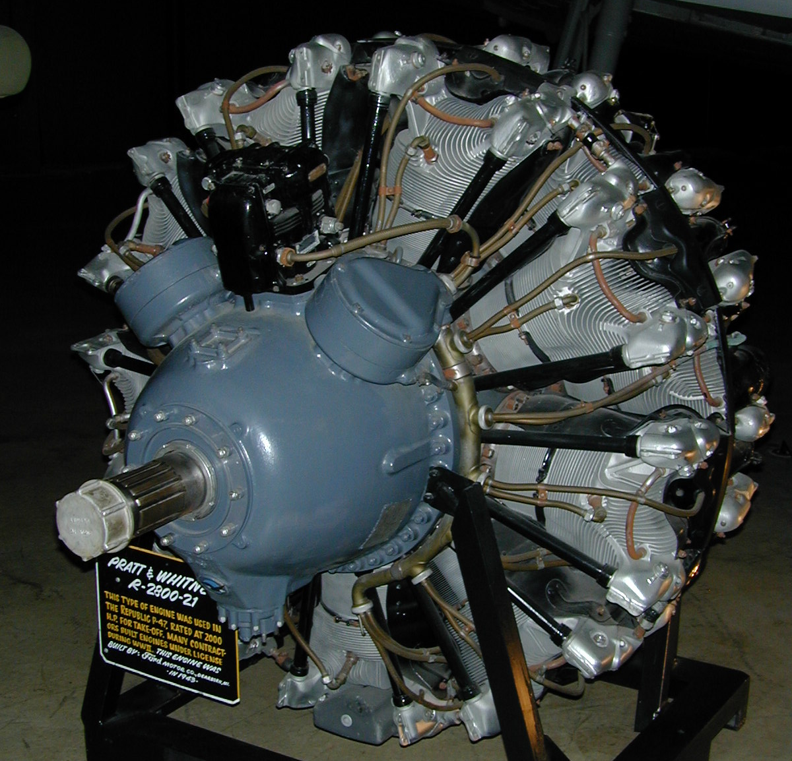
Why gas turbines?
NuCellSys HY-80 “Fuel cell engine” (specs no longer on-line)
Volume 220 liters = 0.41 hp/liter
91 hp, 485 lb. (power/wt = 0.19 hp/lb)
41% efficiency (fuel to electricity) at max. power; up to 58% at lower power
Uses hydrogen - NOT hydrocarbons
Does NOT include electric drive system (≈ 0.40 hp/lb) at ≈ 90% electrical to mechanical efficiency
Fuel cell + motor overall 0.13 hp/lb at 37% efficiency, not including H₂ storage
Pratt & Whitney R-2800 46 liter (2800 in³) 18-cyl. 4-stroke supercharged gasoline engine (used in WWII aircraft)
Total volume 53” dia x 81” length = 2927 liters = 0.72 hp/liter
2100 hp @ 2700 RPM
Dry weight 2360 lb. (power/wt = 0.89 hp/lb = 5.3x lower than gas turbine)
BMEP = 14.9 atm
Volume compression ratio 6.8:1 (= pressure ratio 14.6 if isentropic)

Slide 5
Why gas turbines?
Why do gas turbines have much higher power/weight & power/volume than reciprocating engines? More air can be processed since steady flow, not start/stop
  More air ⇒ more fuel can be burned
  More fuel ⇒ more heat release
  More heat ⇒ more work (if thermal efficiency similar)

Slide 6
Why gas turbines?
Disadvantages
  Compressor is a dynamic device that pushes gas from low pressure (P) to high P without positive sealing like piston/cylinder
    Requires very precise aerodynamics
    Requires blade speeds ≈ sound speed, otherwise gas flows back to low P faster than compressor can push it to high P
    Each stage can provide only 2:1 or 3:1 pressure ratio - need many stages for large pressure ratio
  Since steady flow, each component sees a constant temperature - turbine stays hot continuously and must rotate at high speeds (high stress)
    Severe materials and cooling engineering required (unlike reciprocating engine where components feel only average gas temperature during cycle)
    Turbine inlet temperature limit typically 1400˚C - limits fuel input
  As a result, turbines require more maintenance & are more expensive for same power

Slide 7
Thrust computation
In gas turbine and rocket propulsion we need THRUST (force acting on vehicle)
How much thrust can we get from a given amount of fuel?
Force = d(momentum)/d(time)
  Force = pressure x area; momentum = mass flow x velocity
Goal of propulsion analysis is to compute exhaust velocity and pressure for a given thermodynamic cycle

Slide 8
Thrust computation
Control volume for thrust computation - in frame of reference moving with the engine

Slide 9
Thrust computation - steady flight
Newton's 2nd law: Force = rate of change of momentum
At takeoff u₁ = 0; for rocket no inlet so u₁ = 0 always
For hydrocarbon-air combustion FAR << 1; typically 0.06 at stoichiometric, but maximum allowable FAR ≈ 0.03 due to turbine inlet temperature limitations (discussed later…)

Slide 10
Thrust computation
But how to compute exit velocity (u₉) and exit pressure (P₉) as a function of ambient pressure (P₁), flight velocity (u₁)? Need compressible flow analysis, next lecture …
Also - one can obtain a given thrust with large (P₉ – P₁)A₉ and a small [(1+FAR)u₉ - u₁] or vice versa - which is better, i.e. for given u₁, P₁, and FAR, what P₉ will give most thrust? Differentiate thrust equation and set = 0
Momentum balance at exit (see next slide)
Combine
Optimal performance occurs for exit pressure = ambient pressure
Valid for any 1-D steady cycle (ideal or not), any material

Slide 11
1D momentum balance - constant-area duct
Coefficient of friction (C_{f})

Slide 12
Thrust computation
Wait – this says P₉ = P₁ is an extremum –but is it a minimum or maximum?
but P₉ = P₁ at the extremum cases so
Maximum thrust if d²(Thrust)/d(P₉)² < 0 ⇒ dA₉/dP₉ < 0 - we will show this is true for supersonic exit conditions
Minimum thrust if d²(Thrust)/d(P₉)² > 0 ⇒ dA₉/dP₉ > 0 - we will show this is true for subsonic exit conditions, but for subsonic, P₉ = P₁ always since acoustic (pressure) waves can travel up the nozzle, equalizing the pressure to P₉, so it's a moot point

Slide 13
Thrust computation
Turbofan: same as turbojet except that there are two streams, one hot (combusting) and one cold (non-combusting, fan only, use prime (') superscript):
Note (1 + FAR) term applies only to combusting stream
Note we assumed P₉ = P₁ for fan stream; for any sane fan design u₉' will be subsonic so P₉ = P₁ will be true

Slide 14
Propulsive, thermal, overall efficiency
Thermal efficiency (η_{th})
Propulsive efficiency (η_{p})
Overall efficiency (η_{o})
this is the most important efficiency in determining aircraft performance (see Breguet range equation, coming up…)

Slide 15
Propulsive, thermal, overall efficiency
Note on propulsive efficiency
  η_{p} → 1 as Δu → 0 ⇒ u₉ is only slightly larger than u₁
  But then you need large mass flow rate ( ) to get the required Thrust ~ Δu - but this is how turbofan engines work!
  In other words, the best propulsion system accelerates an infinite mass of air by an infinitesimal Δu
  Fundamentally this is because Thrust ~ Δu = u₉ – u₁, but energy required to get that thrust ~ (u₉² - u₁²)/2
  This issue will come up a lot in the next few weeks!

Slide 16
Other performance parameters
Specific thrust – thrust per unit mass flow rate, non-dimensionalized by sound speed at ambient conditions (c₁)
For any 1D steady propulsion system
For any 1D steady propulsion system if working fluid is an ideal gas with constant C_{P}, γ

Slide 17
Other performance parameters
Specific thrust (ST) continued… if P₉ = P₁ and FAR << 1 then
Thrust Specific Fuel Consumption (TSFC) (PDR's definition)
Usual definition of TSFC is just , but this is not dimensionless; use Q_{R} to convert to heat input, one can use either u₁ or c₁ to convert the denominator to a quantity with units of power, but using u₁ would make TSFC blow up at u₁ = 0
Specific impulse (I_{sp}) = thrust per weight (on earth) flow rate of fuel (plus oxidant if two reactants carried, e.g. rocket) (units of seconds)

Slide 18
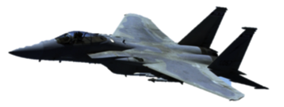
Breguet range equation
Consider aircraft in level flight
(Lift = Weight) at constant flight
velocity u₁ (Thrust = Drag)
Combine expressions for lift & drag and integrate from time t = 0 to t = R/u₁ (R = range = distance traveled), i.e. travel time, to obtain Breguet Range Equation
Lift (L)
Thrust
Drag (D)
Weight (W = m_{vehicle}g)

Slide 19
Rocket equation
If acceleration (Δu) rather than range in steady flight is desired [neglecting drag (D) and gravitational pull (W)], Force = mass x acceleration or Thrust = m_{vehicle}du/dt
Since flight velocity u₁ is not constant, overall efficiency is not useful; instead use I_{sp}, leading to Rocket Equation:
Gravity and aerodynamic drag will increase Δu requirement for a given mission above that required by orbital mechanics alone

Slide 20
Breguet & rocket equations - comments
Range (R) for aircraft depends on
  η_{o} (propulsion system)
  Q_{R} (fuel)
  L/D (lift to drag ratio of airframe)
  g (gravity)
  Fuel consumption (m_{initial}/m_{final}); m_{initial} - m_{final} = fuel mass burned (or fuel + oxidizer, if not airbreathing)
R does not consider extra fuel mass required for taxi, takeoff, climb, decent, landing, fuel reserve, etc.
Note (irritating) ln( ) or exp( ) term in both Breguet and Rocket
that occurs because more thrust is required at the beginning of the flight to carry fuel that won’t be used until the end of the flight - if not for ln( ) term it would be easy to fly around the world without refueling and the Chinese would have sent skyrockets into orbit thousands of years ago!

Slide 21
Examples
What initial to final mass ratio is needed to fly around the world without refueling?
  Assume distance traveled (R) = 40,000 km, g = 9.8 m/s²; hydrocarbon fuel (Q_{R} = 4.3 x 10⁷ J/kg); good propulsion system (η_{o} = 0.25), good airframe (L/D = 25),
  So the aircraft takeoff mass has to be mostly fuel, i.e. m_{fuel}/m_{initial} = (m_{initial} - m_{fina}l)/m_{initial} = 1 - m_{final}/m_{initial} = 1 - 1/4.31 = 0.768! – that's why no one flew around with world without refueling until 1986 (solo flight 2005)
What initial to final mass ratio is needed to get into orbit from the earth's surface with a single-stage rocket propulsion system?
  For this mission Δu = 8000 m/s; using a good rocket propulsion system (e.g. Space Shuttle main engines, I_{SP} ≈ 400 sec
  It's practically impossible to obtain this large a mass ratio in a single stage, thus staging is needed where you jettison larger, heavier stages as fuel mass is consumed – that's why no one put an object into earth orbit until 1957, and no one has ever built a single stage to orbit vehicle.

Slide 22
Summary
Steady flow (e.g. gas turbine) engines have much higher power-to-weight ratios than unsteady flow (e.g. reciprocating piston) engines
A simple momentum balance on a steady-flow propulsion system shows that the best performance is obtained when
  Exit pressure = ambient pressure
  A large mass of gas is accelerated by a small Δu
Two types of efficiencies for propulsion systems - thermal efficiency and propulsive efficiency (product of the two = overall efficiency, which is the most important figure of merit)
Definitions - specific thrust, thrust specific fuel consumption, specific impulse
Range of an aircraft depends critically on overall efficiency - effect more severe than in ground vehicles, because aircraft must generate enough lift (thus thrust, thus required fuel flow) to carry entire fuel load at first part of flight

